Slide 1
03/04/2025
Hybrid Homomorphic Encryption Resistance to Side-channel Attacks
CASCADE Conference
Pierugo Pace (NAGRA Kudelski Group / EPFL), Hervé Pelletier (NAGRA Kudelski Group), Serge Vaudenay (EPFL)

Slide 2
Table of Contents
Context
Attack results
Defense and its effectiveness
Deep Learning to bypass countermeasures
Conclusion and future work

Slide 3
Context
Cloud services become more popular
Privacy concerns as data is processed unencrypted
Idea: process data that stays encrypted
Fully Homomorphic Encryption [1]:
Confidentiality
$$f\left(HEnc_{{HK}_{pub}}\left(x\right)\right)=HEnc_{{HK}_{pub}}\left(f\left(x\right)\right)$$
Actual encryption is expensive
Especially for IoT
→ Hybrid Homomorphic Encryption [2]
[1] https://www.cs.cmu.edu/~odonnell/hits09/gentry-homomorphic-encryption.pdf
[2] https://eprint.iacr.org/2011/405.pdf

Slide 4
Hybrid Homomorphic Encryption
$$f\left(HEnc_{{HK}_{pub}}\left(x\right)\right)=HEnc_{{HK}_{pub}}\left(f\left(x\right)\right)$$
CONTEXT
Legend:
: $HEnc_{{HK}_{pub}}\left(x\right)$
: $SEnc_{SK}(x)$
$$x$$
$$x$$
$$SK,HK_{pub}, HK_{priv}$$
$$HK_{pub}$$
$$m$$
SK
$$f′( SK , )=f′\left( SK, \right)=$$
$$m$$
$$m$$
, $f$
$$m$$
$$m$$
$$f′\left(∙,∙\right)≔SDec_{∙}(∙)$$
$$SDec_{ SK}( )=$$
$$m$$
$$m$$
$$f\left(m\right)$$
$$f\left( m \right)=$$
$$f\left(m\right)$$
$$f\left(m\right)=HDec_{HK_{priv}}( f\left(m\right) )$$

Slide 5
Hybrid Homomorphic Encryption
CONTEXT
Same guarantees as Fully Homomorphic Encryption
Confidentiality
Computation on encrypted data
Smaller ciphertexts → less bandwidth used
Overhead shifted to the server
Perfect for IoT !
Symmetric decryption must be efficient homomorphically
→ Elisabeth-b4 !

Slide 6
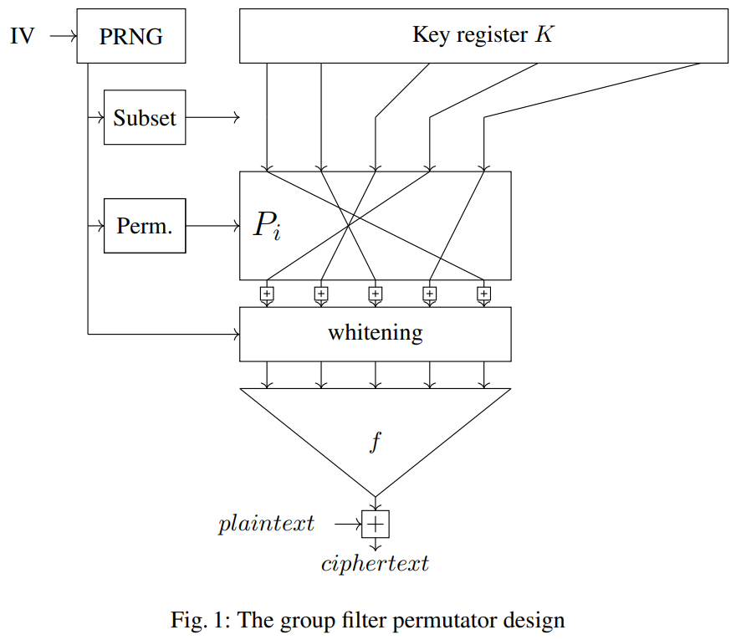
Elisabeth-b4 [3]
Symmetric stream cipher operating in $ℤ_{16}$
Designed to be easily decryptable homomorphically
Stream:
512-nibble key
Random whitened subset (RWS) → 98-nibble keyround
Keyround divided in 14 blocks of size 7 and function $f$ is applied to each of them
[3] https://eprint.iacr.org/2023/1895.pdf

Slide 7
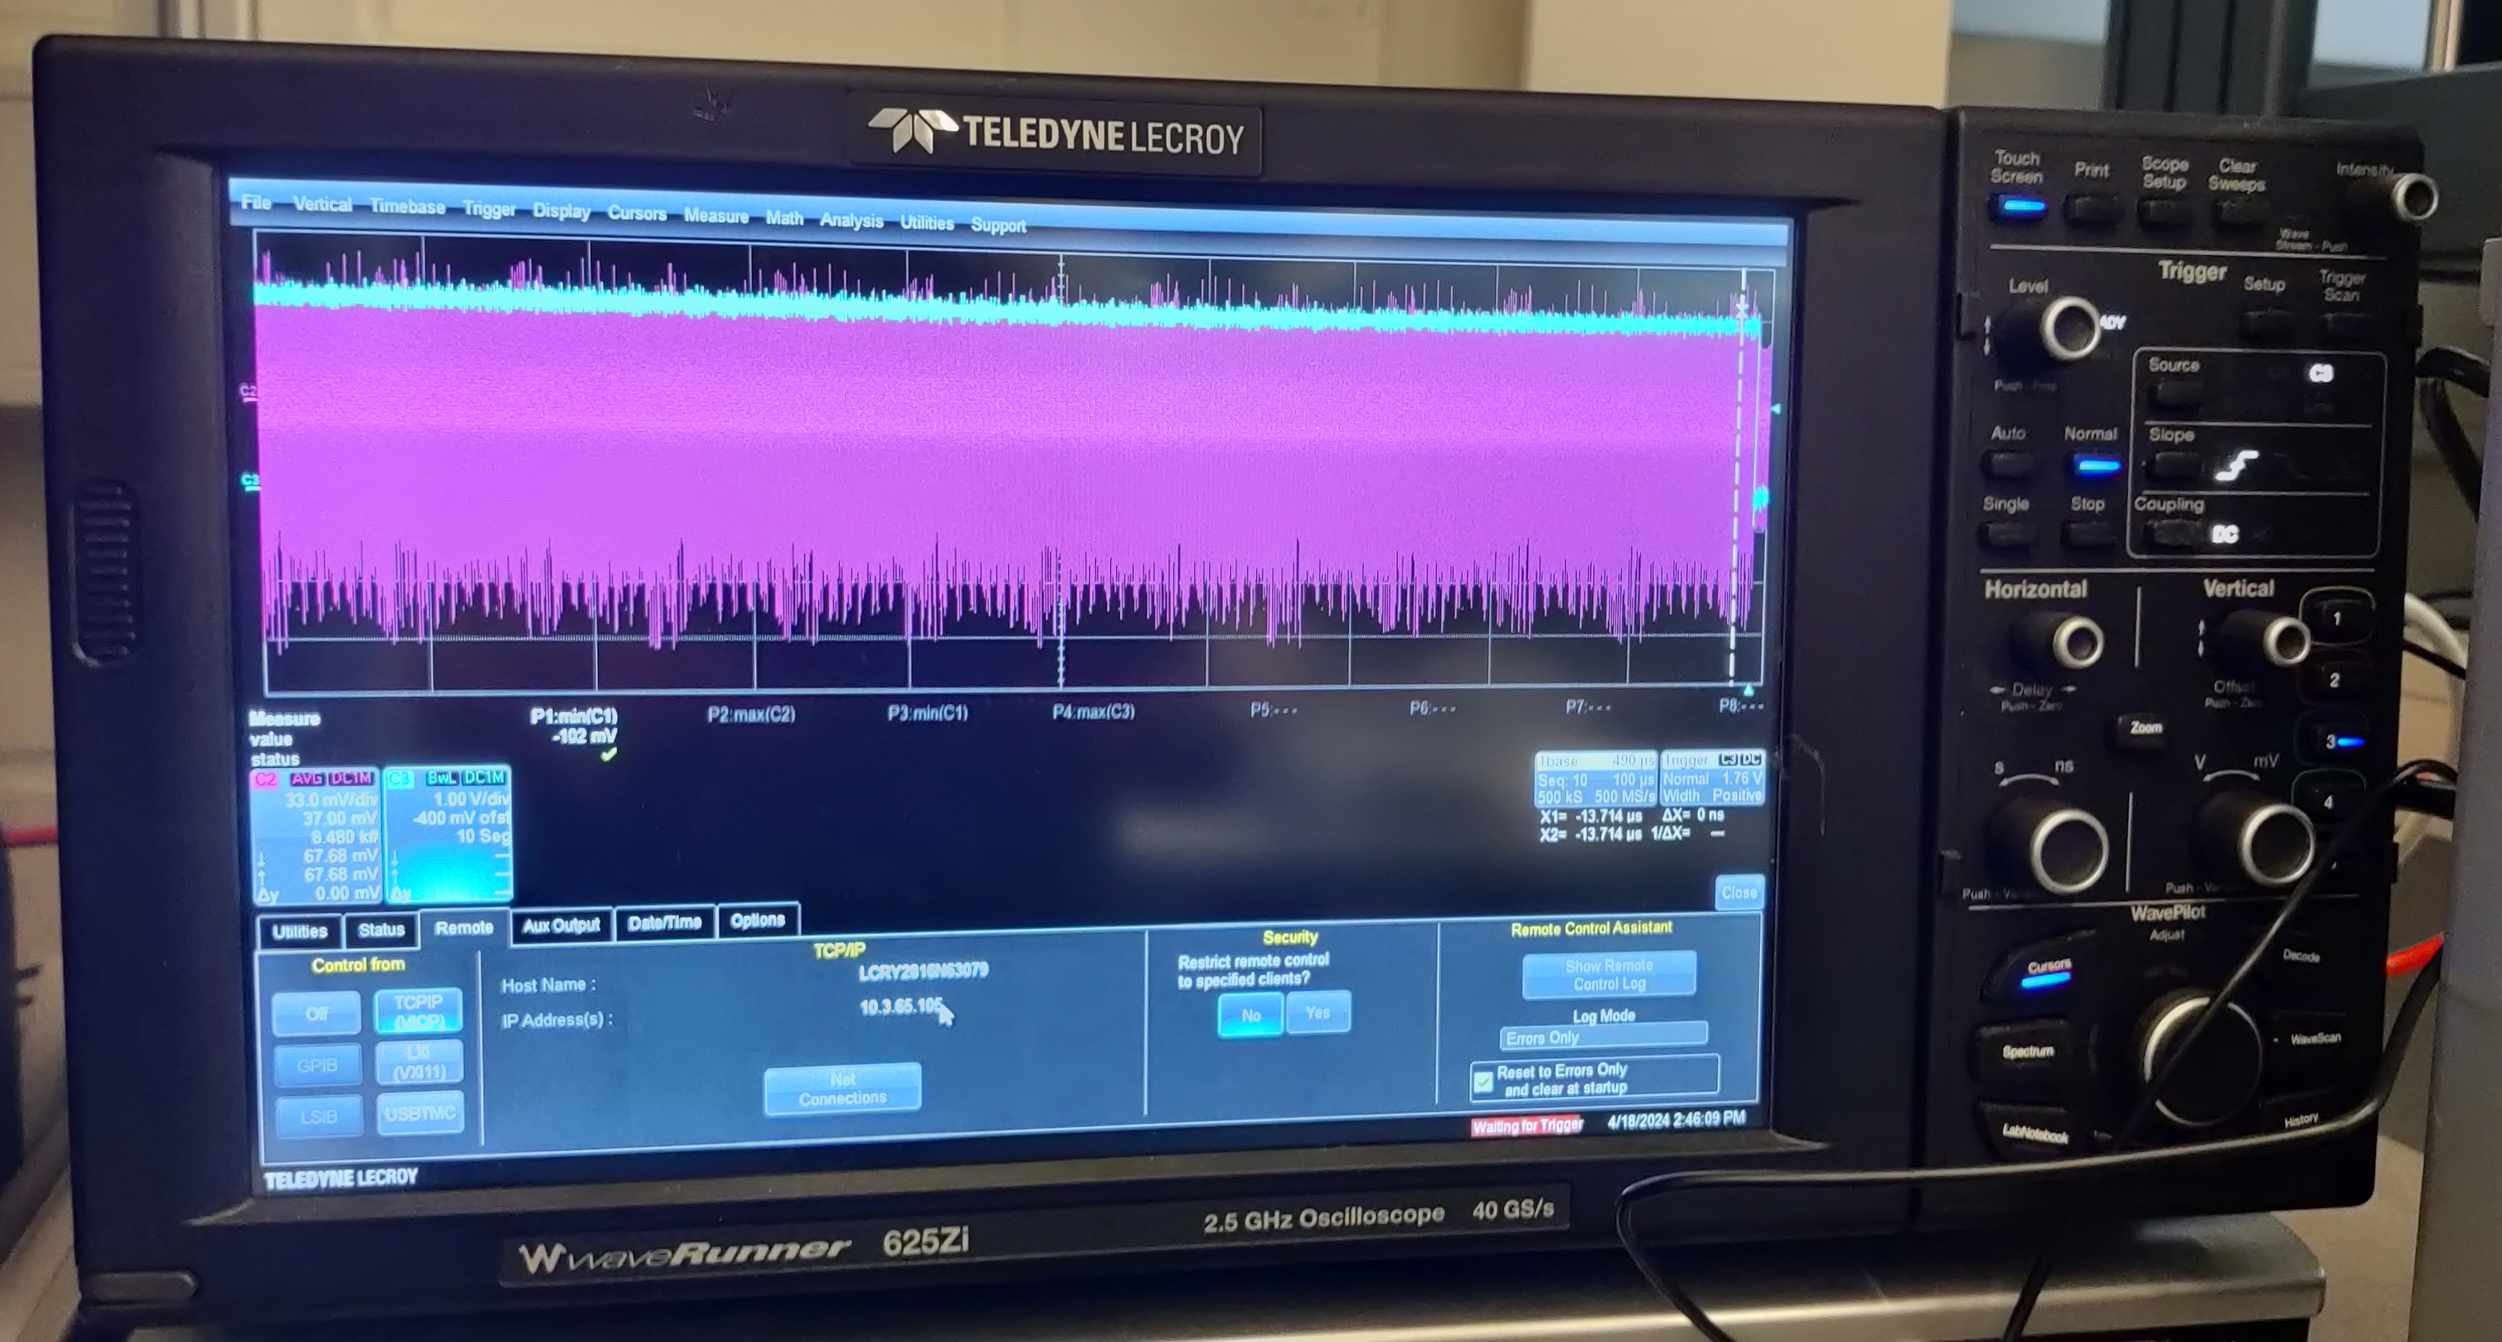
Setup
ATTACKS
(Kudelski IoT Security Evaluations Lab)

Slide 8
Traces collection
ATTACKS
$160 μs$ @500Ms/s → 80 000 timepoints per trace

Slide 9
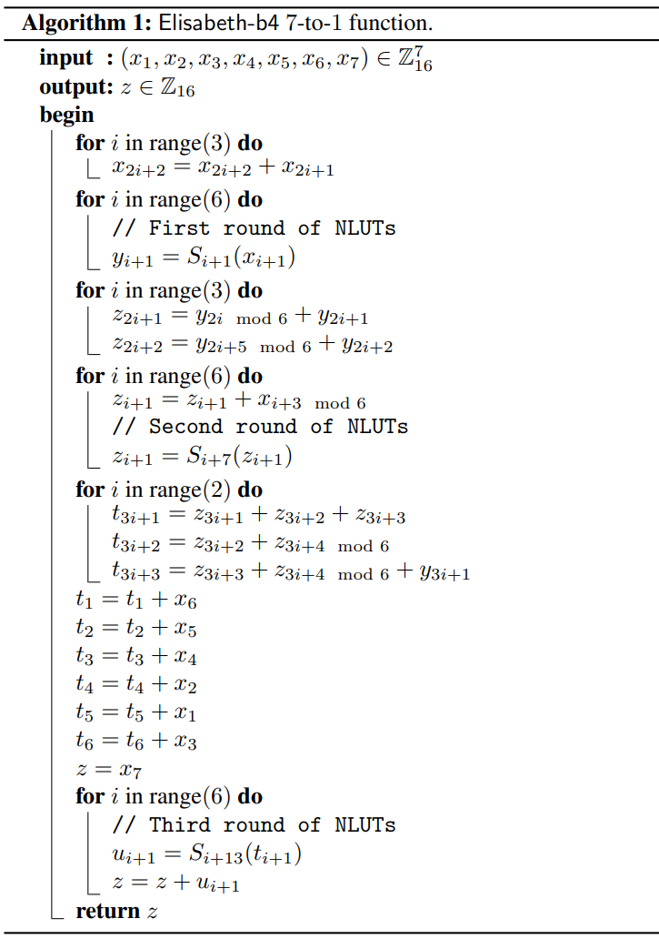
Correlation Power Analysis [4]
ATTACKS
Additions and S-boxes
Efficiently decryptable homomorphically
Recover element by element
Revert RWS thanks to public IV
Requires 35 000 traces to retrieve the entire key
Only targeting one of the S-boxes’ output
With 4-bit hypotheses on a 32-bit processor
[4] https://iacr.org/archive/ches2004/31560016/31560016.pdf

Slide 10
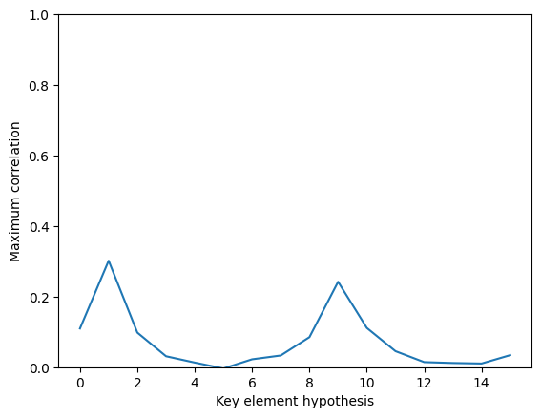
Correlation Power Analysis [4]
ATTACKS
Maximum correlation factor across the entire trace.
Real key element is 1.
$$S_{4}\left(x+8 mod 16\right)=−S_{4}\left(x\right) mod 16$$
[4] https://iacr.org/archive/ches2004/31560016/31560016.pdf

Slide 11
Templates (Multivariate Gaussian) [5]
PROFILING ATTACKS
$98$variables $∈ℤ_{16}$ to predict
Feature selection through PoIs (SOST [6])
Assume traces follow a multivariate Gaussian distribution
_{Train size} ^{Test size} | 500 | 750 | 1 500 | 2 500
60 000 | 94.84 ± 1.96% | 98.12 ± 1.22% | 99.92 ± 0.10% | 100.00 ± 0.00%
100 000 | 98.01 ± 1.04% | 99.53 ± 0.40% | 100.00 ± 0.00% | 100.00 ± 0.00%
Templates key recovery rate (5-fold validated) for different profiling and extraction sizes
[5] https://link.springer.com/content/pdf/10.1007/3-540-36400-5_3.pdf
[6] https://eprint.iacr.org/2014/332.pdf

Slide 12
Countermeasures: Leakage comparison and CPA
DEFENSES
Masking [7] and Shuffling [8]
T-test to find leakage points (TVLA [9])
Eliminated first-order leakage
CPA mitigated with masking shares changing every trace
[7] https://link.springer.com/content/pdf/10.1007/3-540-48059-5_15.pdf
[8] https://link.springer.com/content/pdf/10.1007/978-3-642-34961-4_44.pdf
[9] https://csrc.nist.gov/csrc/media/events/non-invasive-attack-testing-workshop/documents/08_goodwill.pdf

Slide 13
Templates
BYPASSING DEFENSES
Shuffling
→ 16 Random Start Indices
Masking:
98 values each with 2 shares
Separately predicted during RWS and $f$
→ $98∙2∙2=392$ mask shares
Total of 408 variables, compared to 98 without countermeasures
Templates: 20% recovery with 250’000 extraction traces: too complex

Slide 14
Deep Learning
BYPASSING DEFENSES
Similar countermeasures attacked by DL in a 2021 work [10]
A few attempts:
20 billion parameters with the same architecture:
Too many parameters to train
Reduction to 188 million:
Wavelet transform [11], focus on leakage regions, reduce number of intermediary nodes
Performance not satisfactory
Split the trace and train 20 smaller independent models on subwindows of the trace.
Easier to train due to less parameters per model
Use multiple GPUs
[10] https://eprint.iacr.org/2021/592.pdf
[11] https://ieeexplore.ieee.org/document/6472489

Slide 15
Defenses impact
BYPASSING DEFENSES
Method | # Profiling | # Extraction | $p_{rws}$ (%) | $p_{round}$ (%) | $p_{block}$ (%) | $m_{rws}$ (%) | $m_{round}$ (%) | Key recovery (%)
CPA | mitigated | mitigated | - | - | - | - | - | mitigated
Templates | 675,000 | 250,000 | 69.96 | 65.92 | 58.01 | 7.71 | 7.37 | 20.7
Single NN | 675,000 | 250,000 | 74.12 | 58.93 | 37.71 | 6.85 | 6.98 | 12.5
20 NNs | 675,000 | 250,000 | 99.35 | 75.11 | 60.23 | 9.58 | 8.44 | 100
Baseline | 0 | 0 | 1.02 | 7.14 | 14.29 | 6.25 | 6.25 | 6.25
Overall attack results with countermeasures enabled.

Slide 16
Conclusion & Future Work
Side-channel analysis on a new and relevant technology – Hybrid HE
Very feasible to retrieve the whole key without protection
Even with 4-bit leakage on a 32-bit processor
Masking and shuffling increase the attack complexity
250x more traces, need to train several DL models
Future work:
Adapt the architecture of the cipher to eliminate some leaking regions
Analyse how other HHE schemes (Pasta, HERA, Rubato) are affected by the same attacks

Slide 17
Feature Reduction [13]
PROFILING ATTACKS
Sum Of Squared pairwise T-differences (SOST)
$F\left(t\right)=\sum_{i≠j}{{\left(\frac{M_{i}\left(t\right)−M_{j}(t)}{\sqrt{{σ_{i}^{2}\left(t\right)}/{\left|G_{i}\right|}+{σ_{j}^{2}\left(t\right)}/{\left|G_{j}\right|}}}\right)}^{2}, i, j∈\left\{0,…,15\right\}}$
Measure of discriminatory potential for each timepoint
Choose the timepoints of the N highest values
Automatic process to capture the maximal information from the traces
Repeat for each of the 98 key values
[13] https://eprint.iacr.org/2014/332.pdf

Slide 18
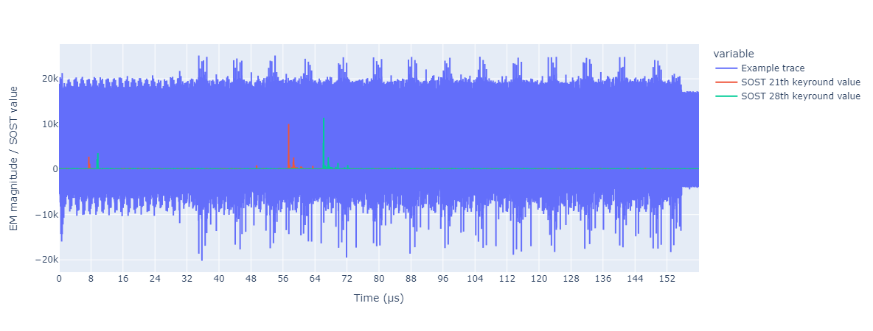
Feature Reduction [13]
PROFILING ATTACKS
Example of SOST functions on top of a trace.
[13] https://eprint.iacr.org/2014/332.pdf

Slide 19
PoIs of 2nd order Haar transform of whole trace
12,150
ResNet
9 residual blocks
3,072
Dense
Dense
Dense
Dense
Dense
Dense
Dense
Dense
512
128
128
512
512
512
128
128
ReLU
ReLU
ReLU
ReLU
ReLU
ReLU
ReLU
ReLU
512
128
···
128
512
512
···
512
128
···
128
BN
BN
196
BN
BN
14
BN
BN
196
BN
BN
512
128
128
512
512
512
128
128
Dense
Dense
Dense
Dense
Dense
Dense
Dense
Dense
98
16
16
14
7
7
16
16
Softmax
Softmax
Softmax
Softmax
Softmax
Softmax
Softmax
Softmax
98
16
16
14
7
7
16
16
$$f_{p_{rws}}\left(∙| x\right)$$
$$f_{m_{0}^{rws}[0]}\left(∙| x\right)$$
$$f_{m_{97}^{rws}[1]}\left(∙| x\right)$$
$$f_{p_{round}}\left(∙| x\right)$$
$$f_{p_{block_{0}}}\left(∙| x\right)$$
$$f_{p_{block_{13}}}\left(∙| x\right)$$
$$f_{m_{0,0}^{rounds}[0]}\left(∙| x\right)$$
$$f_{m_{13,6}^{rounds}[1]}\left(∙| x\right)$$
Initial neural network architecture

Slide 20
RWS perm (11,497,410 params)
Round perm (4,389,998 params)
RWS
$p_{round}$’s PoIs
19850
700
ResNet
10 residual blocks
ResNet
5 residual blocks
2304
2816
Dense
Dense
1024
1024
ReLU
ReLU
1024
1024
BN
BN
1024
1024
Dense
Dense
98
14
Softmax
Softmax
98
14
$$f_{p_{rws}}\left(∙| x\right)$$
$$f_{p_{round}}\left(∙| x\right)$$
Our modular network architectures (1/2)

Slide 21
¼ RWS masks (63,107,168 params)
Round masks and perms (26,213,447 params)
¼ RWS
Round $0$
4875
1400
ResNet
8 residual blocks
ResNet
6 residual blocks
2304
2816
Dense
Dense
Dense
Dense
Dense
512
512
1024
512
512
ReLU
ReLU
ReLU
ReLU
ReLU
512
···
512
1024
512
···
512
48
14
BN
BN
BN
BN
BN
512
512
1024
512
512
Dense
Dense
Dense
Dense
Dense
16
16
7
16
16
Softmax
Softmax
Softmax
Softmax
Softmax
16
16
7
16
16
$$f_{m_{rws_{0,0}}}\left(∙| x\right)$$
$$f_{m_{rws_{23,1}}}\left(∙| x\right)$$
$$f_{p_{block_{0}}}\left(∙| x\right)$$
$$f_{m_{round_{0,0}}}\left(∙| x\right)$$
$$f_{m_{round_{6,1}}}\left(∙| x\right)$$
Our modular network architectures (2/2)

Slide 22
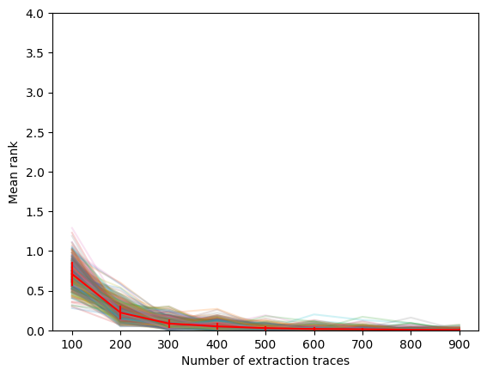
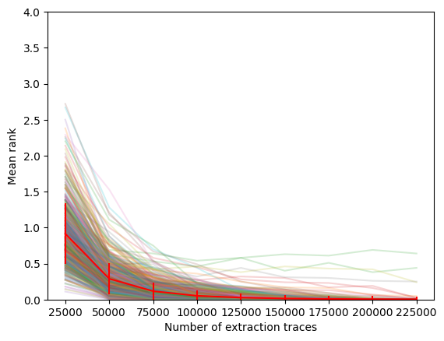
Guessing entropies
PROFILING ATTACKS
Templates – without countermeasures
20 NNs – with countermeasures

Slide 23
An innovative countermeasure
DEFENSES
Two major observations of the Deep Learning attack
Training and inference done on different devices
Too complex without reducing input size and focusing on leaking regions
Goal: change data distribution between training and inference phases
Inject unpredictable delays consistent to each device
Harnessing a secret specific to the device
Delays also change every time the key changes
Complexify attacker that can directly train on the target

Slide 24
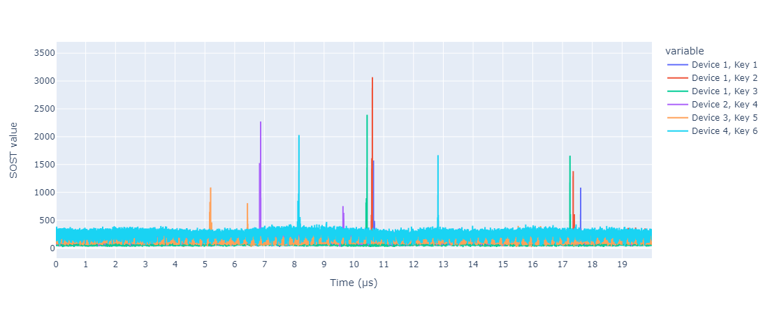
Effects on leakage regions
AN INNOVATIVE COUNTERMEASURE

