Slide 1
Avenger Ensemble: Genetic Algorithm-Driven Ensemble Selection for Deep Learning-based Side-Channel Analysis
Zhao Minghui and Trevor Yap
2nd April 2025

Slide 2
Outline
Introduction
Evolutionary Avengers Initiative (EAI)
Initialization
Evaluation & Elitism
Genetic Operations
Experiments
Future Work

Slide 3
Outline
Introduction
Evolutionary Avengers Initiative (EAI)
Initialization
Evaluation & Elitism
Genetic Operations
Experiments
Future Work

Slide 4
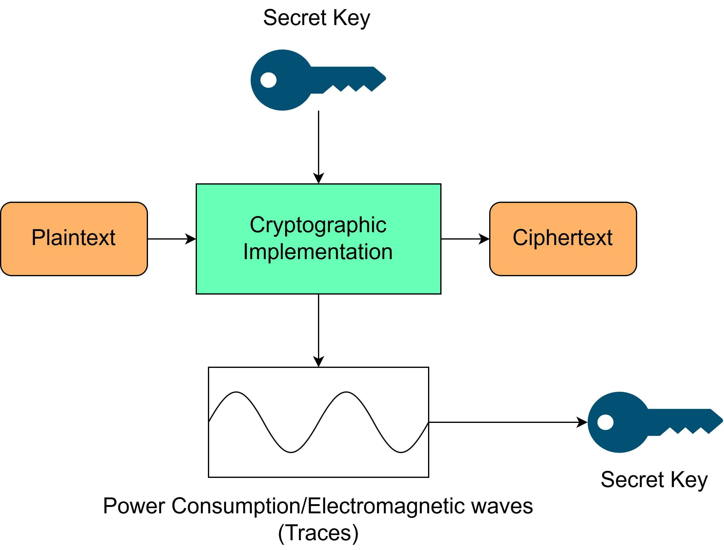
Overview of Side-Channel Analysis

Slide 5
Profiling Attack

Slide 6
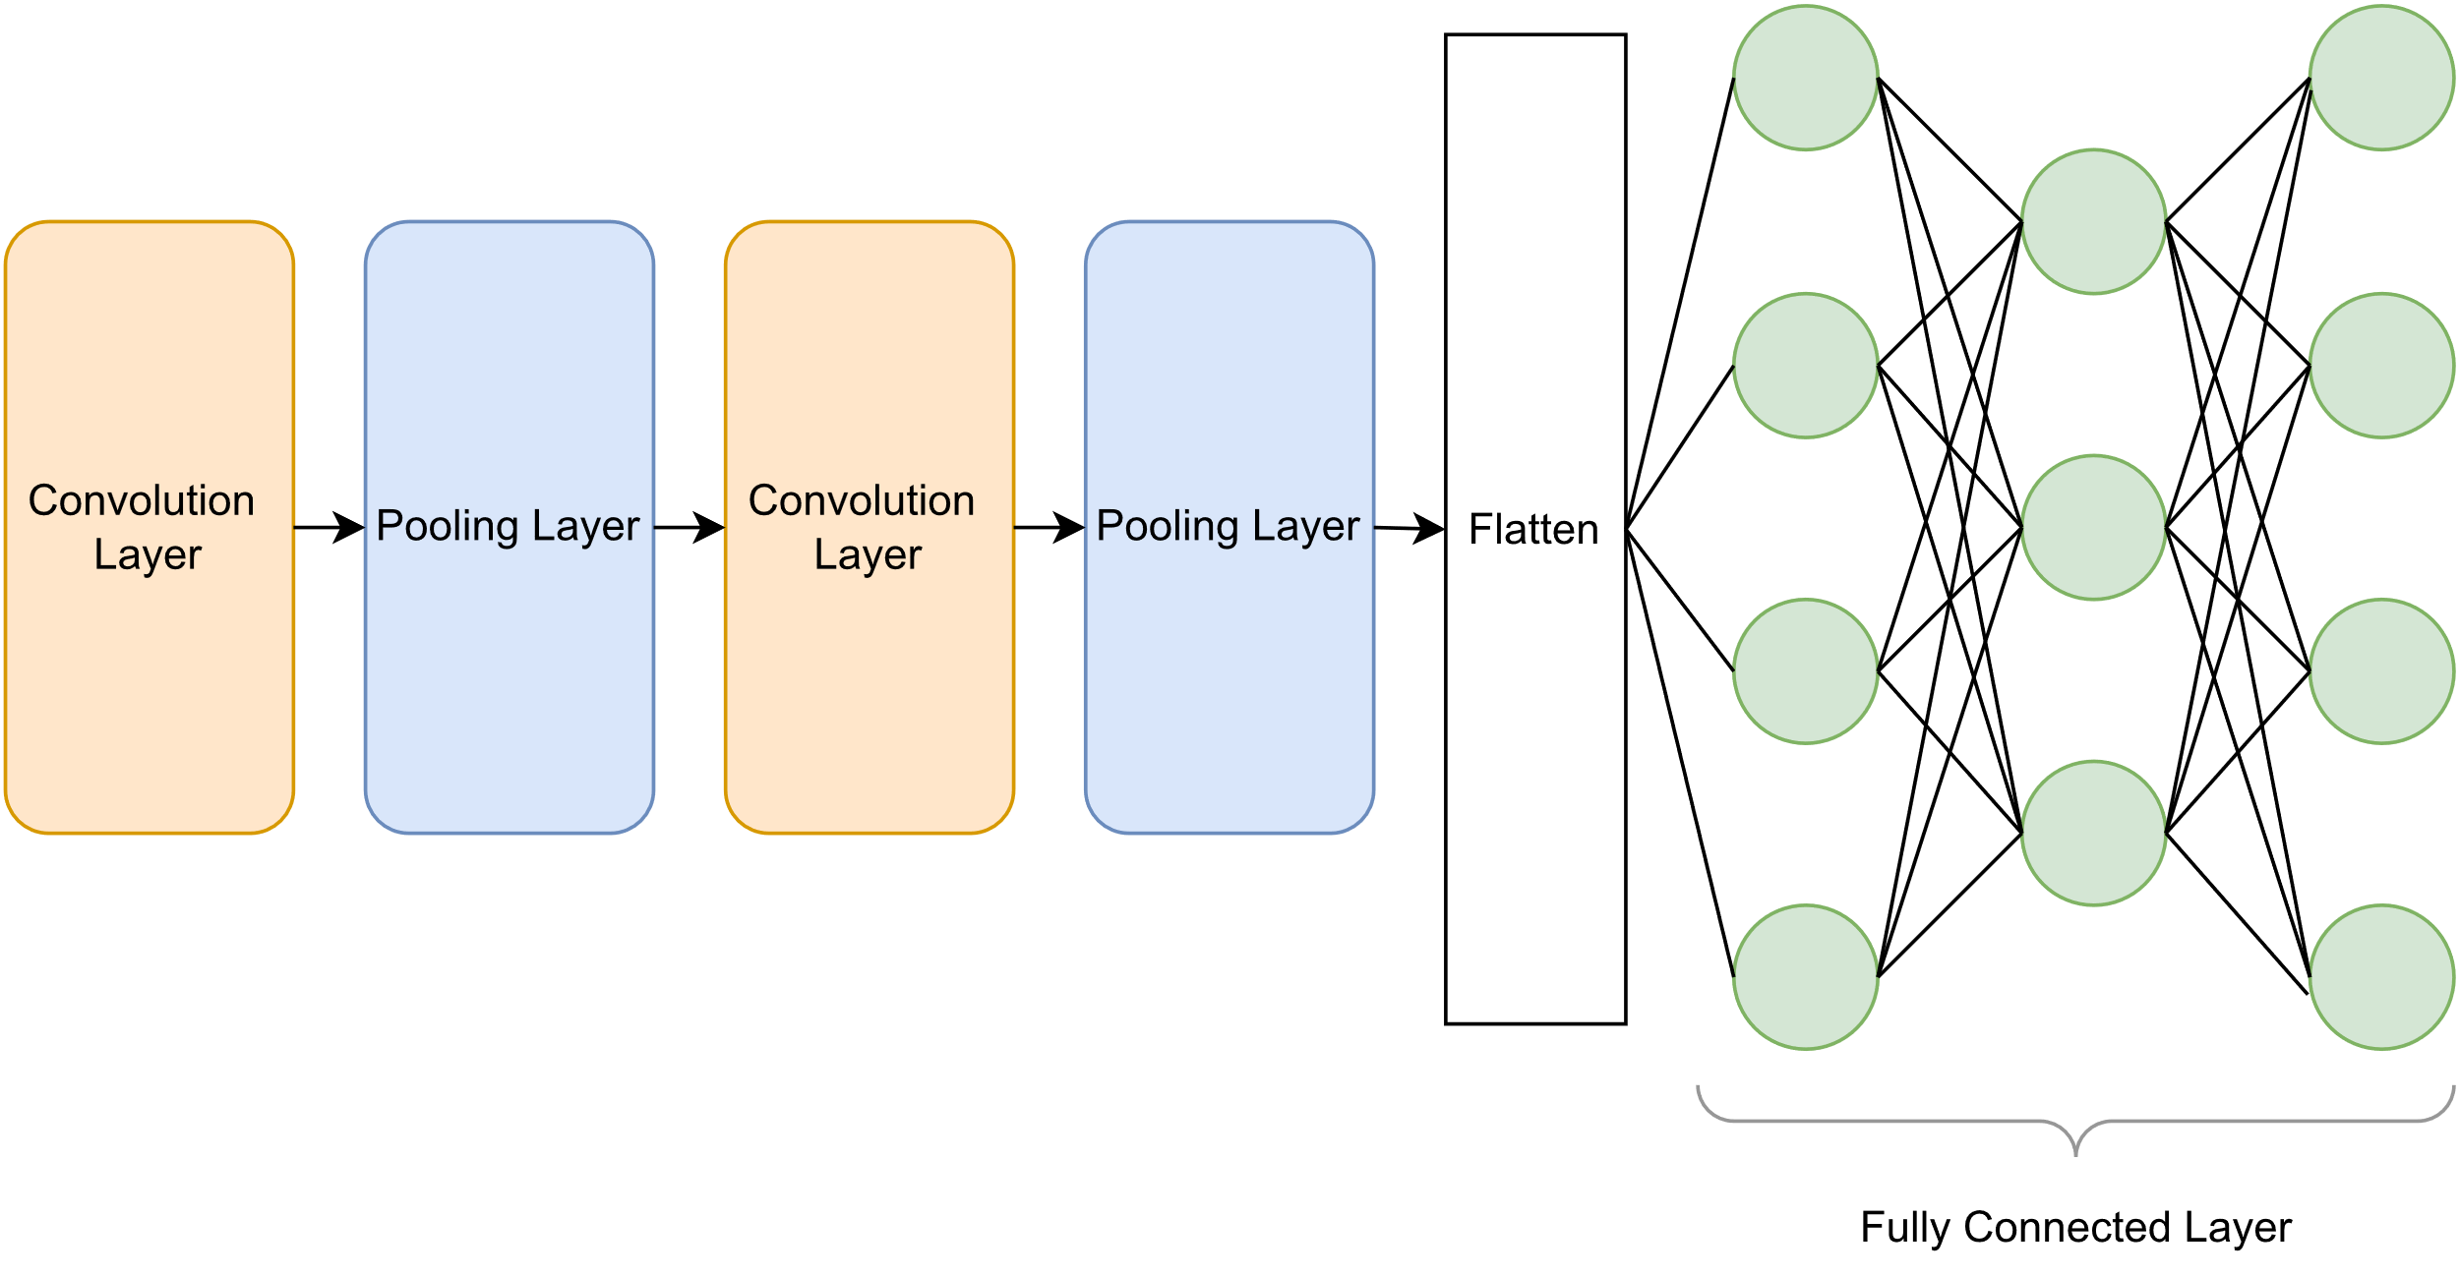
Deep Neural Networks (DNNs)
DNNs are layers of weights trained for various tasks.
Common DNNs are like Multilayer Perceptrons (MLPs) and Convolutional Neural Networks (CNNs)

Slide 7
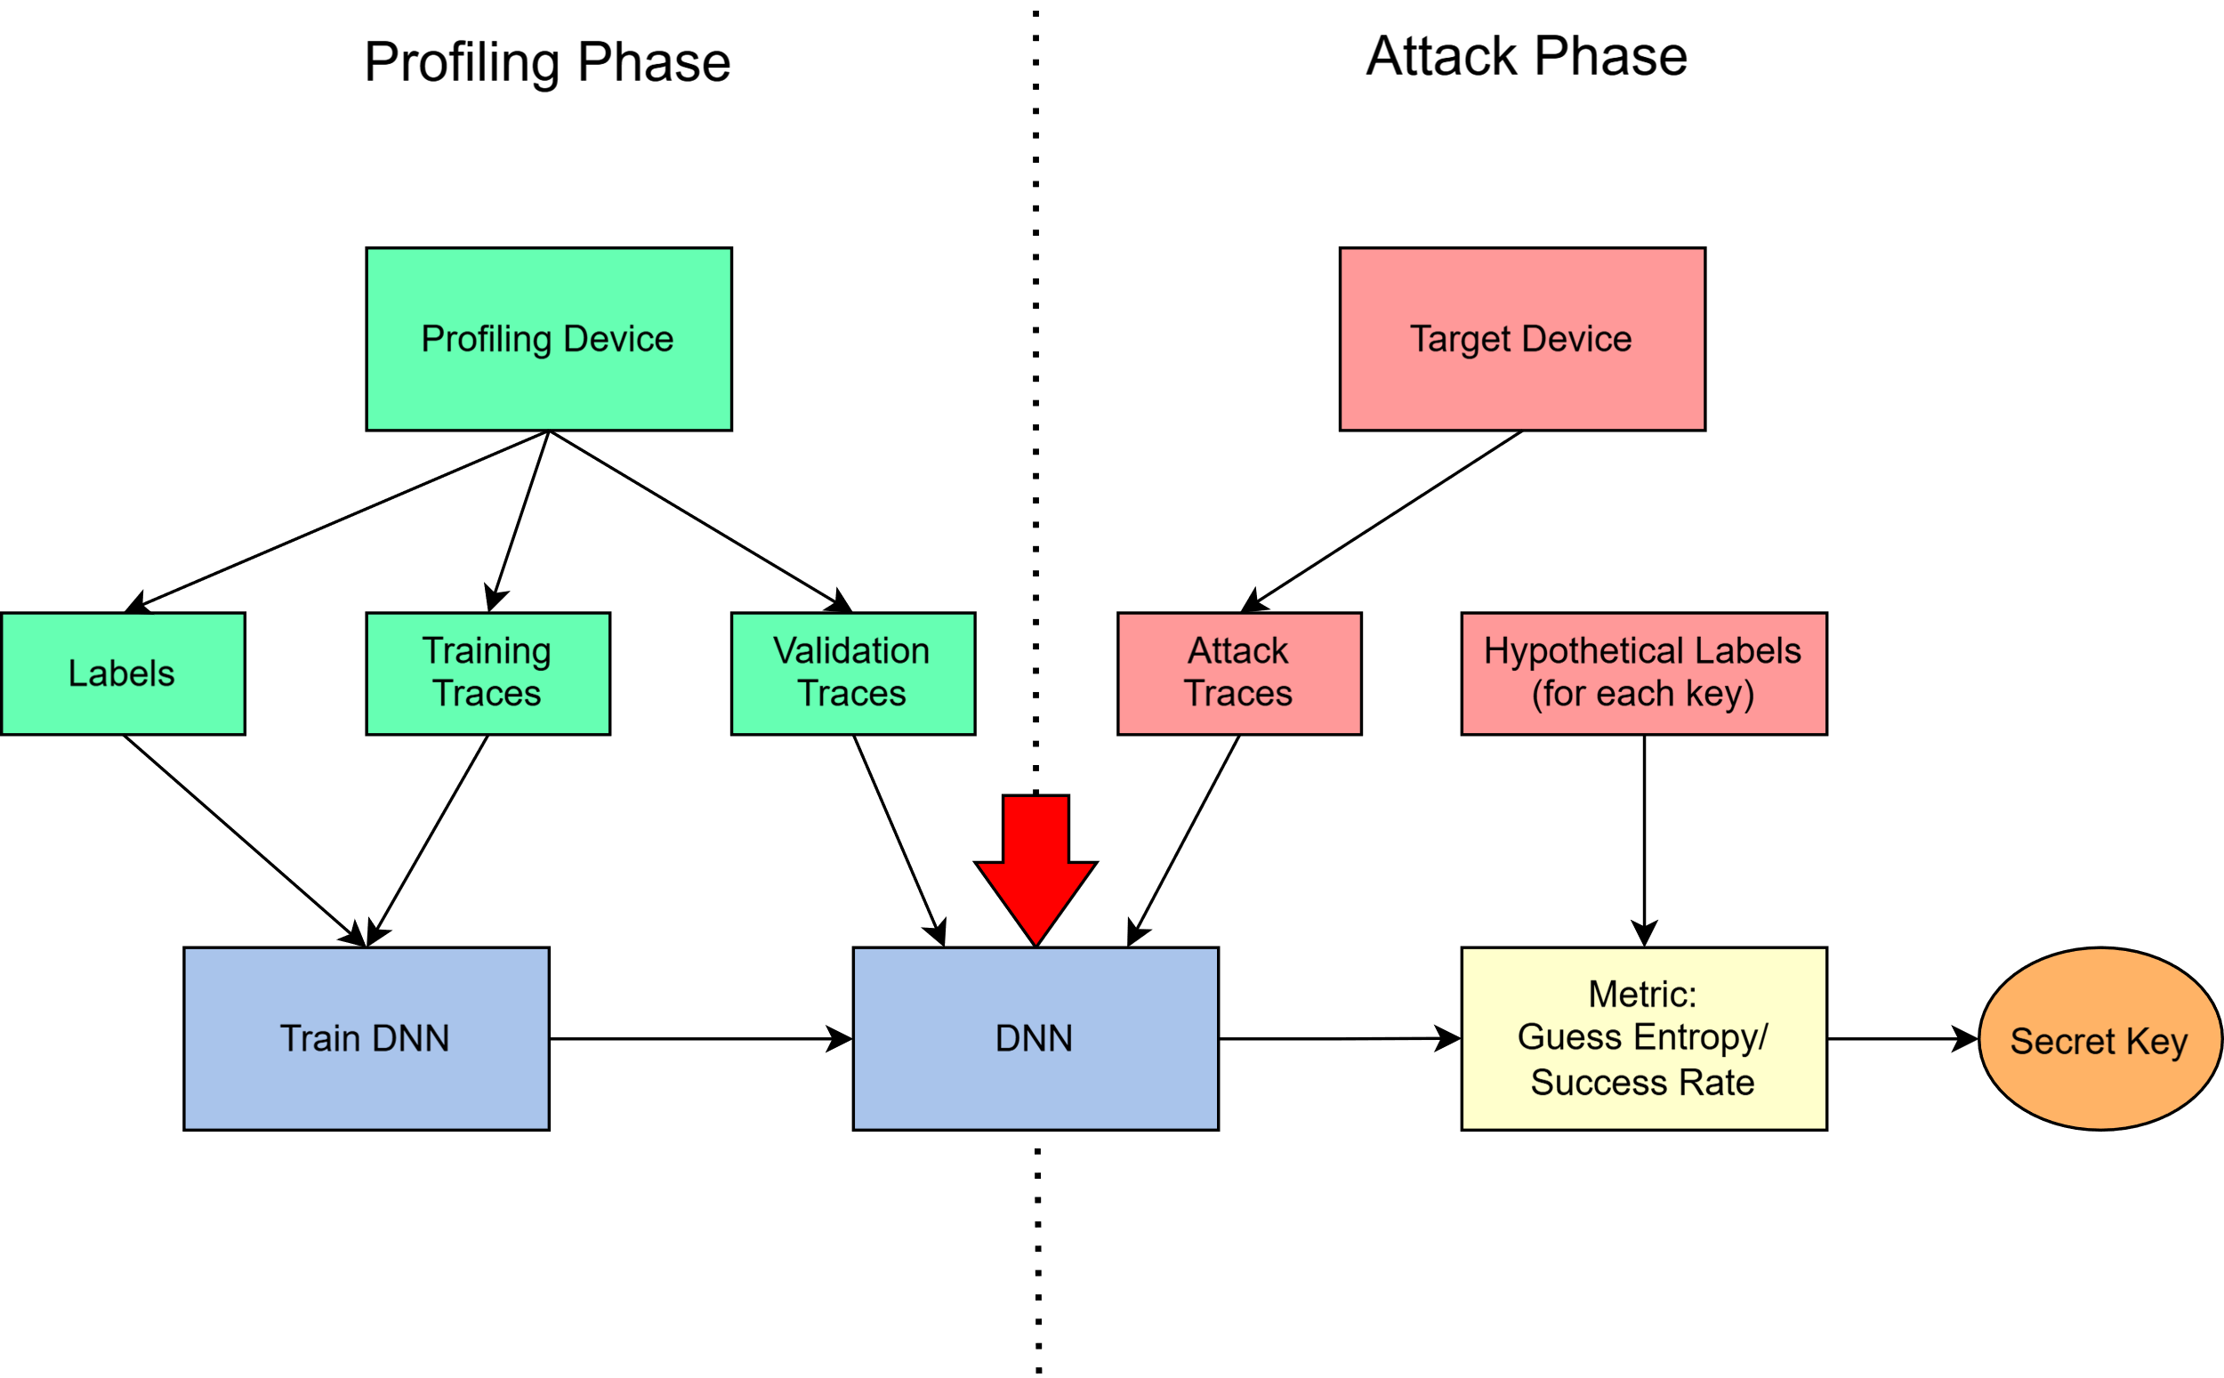
Profiling Attack with DNN
Classical SCA (i.e. Template Attack) | DNN-based attack
More traces to attack | Significantly lesser traces to attack
Preprocessing to remove any desynchronous in the traces | No preprocessing needed
Preprocessing to obtain Points of Interest (PoIs) | No preprocessing needed.

Slide 8
Related Works
Bagging of DNNs in SCA (Perin et al., 2020)
Bagging apply to Ascon dataset (Rezaeezade et al., 2024)
Stacking of DNNs (Llavata et al., 2023)
Boosting of DNNs (Wang & Dubrova, 2021)
Ensemble Loss (Zaid et al., 2021)
They have demonstrated that ensembling multiple DNNs yields substantial performance gains compared to a single top-performing neural network.
Focus on Bagging of DNNs in SCA.

Slide 9
Profiling Attack with Ensemble of DNNs
$$\text{score}\left(k\right)=\sum_{i=1}^{N_{a}}{\log\left(Pr\left(Z = z_{i,k} | t_{i}\right)\right)}$$
$$\text{score}\left(k\right)=\sum_{j=1}^{N_{model}}{\sum_{i=1}^{N_{a}}{\log\left(Pr_{j}\left(Z = z_{i,k} | t_{i}\right)\right)} }$$

Slide 10
Motivation
DNNs of varying hyperparameters can extract different information from identical traces, yielding improved performance when combined together as an ensemble.
Most of the works in DLSCA create an ensemble by greedily selecting the top few best-performing DNNs, herein referred to as the Greedily-Selected Method (GSM).
Can we develop a methodology to efficiently select neural networks for ensembles that outperform the traditional GSM?

Slide 11
Outline
Introduction
Evolutionary Avengers Initiative (EAI)
Initialization
Evaluation & Elitism
Genetic Operations
Experiments
Future Work
Notes:
Thank you all for your applause it's my honor to present our innovative methodology called the Evolutionary Avenger Initiative (EAI)

Slide 12
Avenger Ensemble!
This Photo by Unknown Author is licensed under CC BY-NC-ND
Notes:
Our EAI algorithm, inspired by the Avengers of the Marvel Cinematic Universe, views pre-trained neural networks as "superheroes" with distinct strengths, and automatically assembles the most effective "Avenger Ensemble" to efficiently recover secret keys.

Slide 13
Outline
Introduction
Evolutionary Avengers Initiative (EAI)
Initialization
Evaluation & Elitism
Genetic Operations
Experiments
Future Work

Slide 14
M₀ | M₁ | M₂ | M₃ | M₄ | M₅ | M₆ | M₇ | M₈ | M₉
M₁₀ | M₁₁ | M₁₂ | M₁₃ | M₁₄ | M₁₅ | M₁₆ | M₁₇ | M₁₈ | M₁₉
M₂₀ | M₂₁ | M₂₂ | M₂₃ | M₂₄ | M₂₅ | M₂₆ | M₂₇ | M₂₈ | M₂₉
M₃₀ | M₃₁ | M₃₂ | M₃₃ | M₃₄ | M₃₅ | M₃₆ | M₃₇ | M₃₈ | M₃₉
M₄₀ | M₄₁ | M₄₂ | M₄₃ | M₄₄ | M₄₅ | M₄₆ | M₄₇ | M₄₈ | M₄₉
M₅₀ | M₅₁ | M₅₂ | M₅₃ | M₅₄ | M₅₅ | M₅₆ | M₅₇ | M₅₈ | M₅₉
M₆₀ | M₆₁ | M₆₂ | M₆₃ | M₆₄ | M₆₅ | M₆₆ | M₆₇ | M₆₈ | M₆₉
M₇₀ | M₇₁ | M₇₂ | M₇₃ | M₇₄ | M₇₅ | M₇₆ | M₇₇ | M₇₈ | M₇₉
M₈₀ | M₈₁ | M₈₂ | M₈₃ | M₈₄ | M₈₅ | M₈₆ | M₈₇ | M₈₈ | M₈₉
M₉₀ | M₉₁ | M₉₂ | M₉₃ | M₉₄ | M₉₅ | M₉₆ | M₉₇ | M₉₈ | M₉₉
Ensemble 1
Ensemble2
….
All Models
Ensemble 30
Each ensemble consists of 10 DNNs and without repetition.

Slide 15
Outline
Introduction
Evolutionary Avengers Initiative (EAI)
Initialization
Evaluation & Elitism
Genetic Operations
Experiments
Conclusion & Future Work

Slide 16
Fitness score
𝒗𝒂𝒍_𝒍𝒐𝒔𝒔:
Minimizing categorical cross-entropy loss effectively maximizes the generalization of the mutual information between the leakage model and the trace data (also known as perceived information) in SCA (Masure et al., 2020).
$ge_{+ntge}$:
$$ge_{+ntge}\left(θ\right)=\left\{\begin{aligned}NTGE \\ GE+N_{a}+c\end{aligned}\right.{ if GE = 0, \atop otherwise.}$$
Proposed by (Yap et al., 2024).
Directly consider the attack phase into the objective.
Notes:
We explored two fitness functions,
Val_loss I think everyone should be familiar with this.
The second point is precisely what I want to emphasize
When an ensemble can fully recover the key (GE=0), we directly use NTGE as the fitness value, optimizing for the minimum number of traces needed for a successful attack. When an ensemble cannot fully recover the key, we use GE+Na+c as a penalty term, where Na is the fixed number of attack traces for evaluation, and c is a small positive constant (=100).

Slide 17
Elitism
Ensemble?
Ensemble 1
Ensemble?
Ensemble2
….
Ensemble15
….
Ensemble15
….
Ensemble?
Ensemble 30
Generation i
Generation i+1
Notes:
Next we should apply the elitism to preserve the ensemble with best fitness score for the next generation So now, how should we complete the other 29 ensembles?
It’s through the next step:genetic operation

Slide 18
Outline
Introduction
Evolutionary Avengers Initiative (EAI)
Initialization
Evaluation & Elitism
Genetic Operations
Experiments
Future Work

Slide 19
Tournament Selection
E₂₉
M₃₄ | M₁₇ | M₃₈ | M₂₉ | M₂ | M₅₂ | M₈ | M₃₃ | M₁₃ | M₁₆
$$f(E29)= 23$$
Tournament
E₁₃
M₉₂ | M₇ | M₆ | M₂₀ | M₄₃ | M₄₂ | M₂₁ | M₃₈ | M₁₄ | M₃₄
$$f(E13)= 25$$
Best Ensemble
E₉
M₆₄ | M₄₅ | M₄₉ | M₃₂ | M₁₆ | M₂₁ | M₈ | M₁₅ | M₉₀ | M₃₃
$$f(E9)= 4$$
Notes:
For each tournament, 3 ensembles are randomly selected from the 30 ensembles in the current generation. Using the fitness value computed before, pick the best-performing ensemble out of the 3 ensembles.
The best ensemble will be regard as parent，proceed to the next step of genetic operations to supplement the remaining 29 ensembles for next generation.

Slide 20
Tournament Selection
Crossover
Mutation
or

Slide 21
Genetic Operations
Crossover
Parent 1:
M₆₄ | M₄₅ | M₄₉ | M₃₂ | M₄₂ | M₂₁ | M₈ | M₁₅ | M₁₉ | M₃₃
M₃₄ | M₄₅ | M₄₉
M₃₂ | M₄₂ | M₂₁ | M₈
M₃₄ | M₄₅ | M₄₉ | M₃₂ | M₄₂ | M₂₁ | M₈ | M₁₅ | M₁₉ | M₃₃
M₁₅ | M₁₉ | M₃₃
M₁₄ | M₃ | M₃₃ | M₃₅ | M₂₅ | M₂₉ | M₂ | M₄₁ | M₄₄ | M₃₇
Parent 2:
M₁₄ | M₃ | M₃₃
M₃₅ | M₂₅ | M₂₉ | M₂
M₄₁ | M₄₄ | M₃₇
c₁
c₂
Offspring 1:
Offspring 2:
Notes:
Randomly generate two crossover points c1 and c2
Two offspring are generated by exchanging segments between parents from positions c1 to c2:
This crossover operation allows us to explore potentially better combinations. But If the generated offspring already exists in the population, the crossover process is repeated to ensure uniqueness.

Slide 22
Genetic Operations
Mutation
Parent :
M₆₄ | M₄₅ | M₄₉ | M₃₂ | M₁₆ | M₂₁ | M₈ | M₁₅ | M₉₀ | M₃₃
M₃₇
Offspring :
M₆₄ | M₄₅ | M₄₉ | M₃₂ | M₁₆ | M₂₁ | M₈ | M₁₅ | M₉₀ | M₃₃
Randomly Replace
Notes:
The mutation operation requires only one parent
The core of mutation is random replacement: we randomly select a position in the parent and replace it with another DNNs from the initialization

Slide 23
Adaptive Adjustment
Tournament Selection
$${Pr}_{cross}× δ$$
$${Pr}_{mut}×(1+(1−δ))$$
Crossover
Mutation
or
Notes:
Certainly,we’ve considered the diversity.
EAI implements an adaptive adjustment mechanism that dynamically adjusts crossover and mutation rates based on the current population diversity δ.
When population diversity is low, the algorithm increases the mutation rate to introduce more variations; when diversity is high, it increases the crossover rate to more effectively combine existing “parents”.

Slide 24
Outline
Introduction
Evolutionary Avengers Initiative (EAI)
Initialization
Evaluation & Elitism
Genetic Operations
Experiments
Conclusion & Future Work
Notes:
In conclusion,all of the steps of EAI algorithm are involved.So I will show the result for EAI algorithm now.

Slide 25
Datasets
ASCADf.
ASCADr
ASCON2
ASCON4
AES_HD
Notes:
We evaluated EAI's performance across five datasets, including three AES datasets and two Ascon dataset. But I know I have limit time so I will just show the result for 3 datasets.

Slide 26
Hyperparameter Search Space
Parameter | MLP Values | CNN Values
Layers | 1 to 7 (in step of 1) | -
Convolutional Layers | - | 1 - 4 (in step of 1)
Neurons | 10, 20, 50, 100, 200, 300, 400, or 500 | 10, 20, 50, 100, 200, 300, 400, 500
Initial Filters | - | 4, 8, 12, 16
Initial Kernel Size | - | 26 - 52 (in step of 2)
Pooling Type | - | Max pooling, Average pooling
Pooling Size | - | 2, 4, 6, 8, 10
Padding | - | 0, 4, 8, 12, 16
Fully Connected Layers | - | 1-7 (in step of 1)
Activation Functions | ReLU, SELU, ELU, or Tanh | ReLU, SELU, ELU, Tanh
Batch Size | 100 - 1000 (in steps of 100) | 100-1000 (in steps of 100)
Learning Rate | 1e-3, 5e-4, 1e-4, 5e-5, or 1e-5 | 1e-3, 5e-4, 1e-4, 5e-5, 1e-5
Optimizer | RMSprop or Adam | RMSprop, Adam
Weight Initialization | Random uniform, Xavier uniform, or He uniform | Random uniform, Xavier uniform, He uniform

Slide 27
NTGE for different algorithms and leakage models
in the ASCADf dataset
Algorithm | MLP |  | CNN |  | Diverse DNN
 | HW | ID | HW | ID | HW | ID
GSM | 785 | 365 | 825 | 385 | 817 | 329
EAI with ge_{+ntge} | 615 | 29 | 727 | 140 | 590 | 58
EAI with val_loss | (GE = 19) | 98 | (GE = 3) | 615 | (GE = 66) | 113
Notes:
And we also evaluate diverse DNN which consist of 50 MLP and 50 CNN.
The leakage models are Hamming weight and Identity.And we compare 3 different methods.
Here is the result for Ascad fixed dataset
Notably, the MLP model with Identity leakage model achieves the best performance (NTGE = 29). We observed significant differences in per formance between the use of fitness functions when applying EAI.

Slide 28
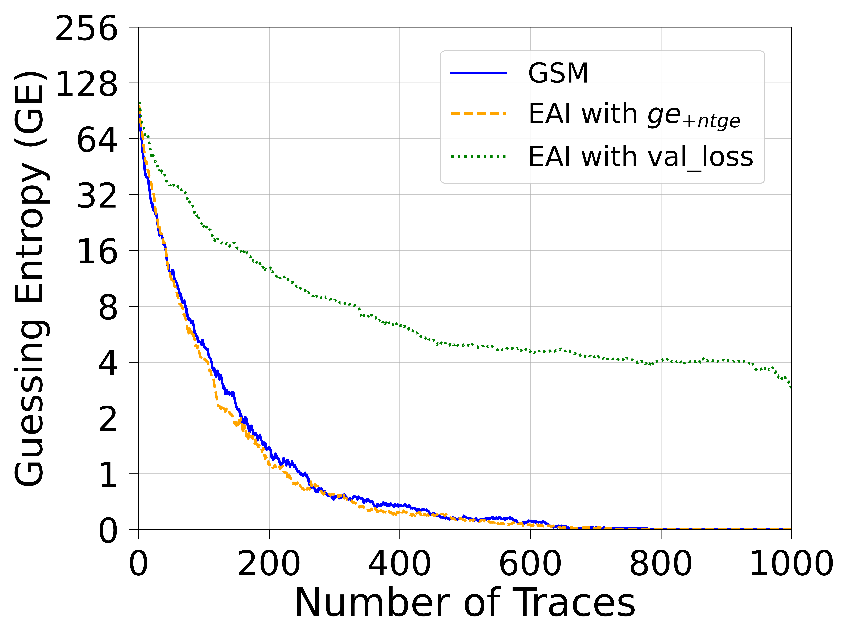
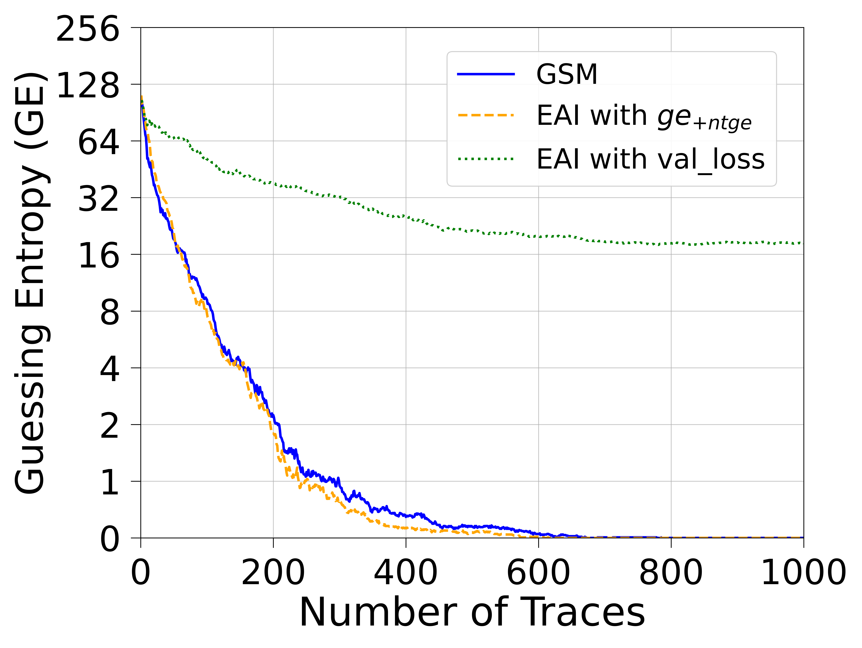
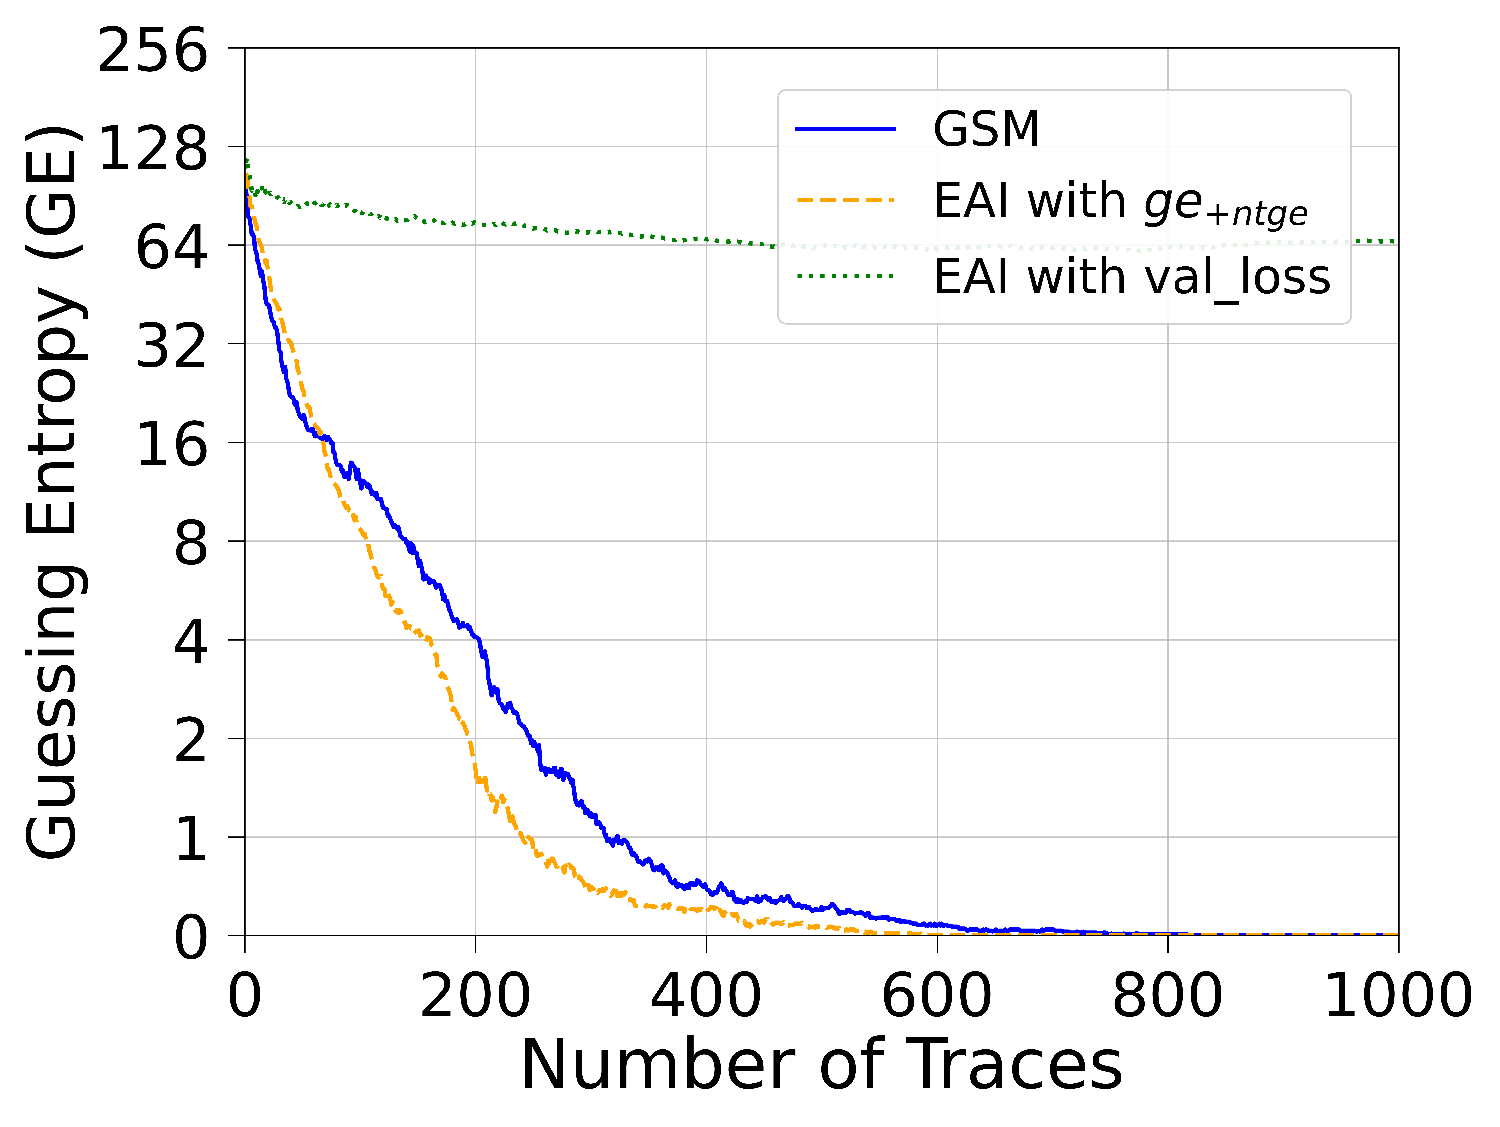
ASCADf (HW)
CNN(HW)
MLP(HW)
CNN&MLP(HW)

Slide 29
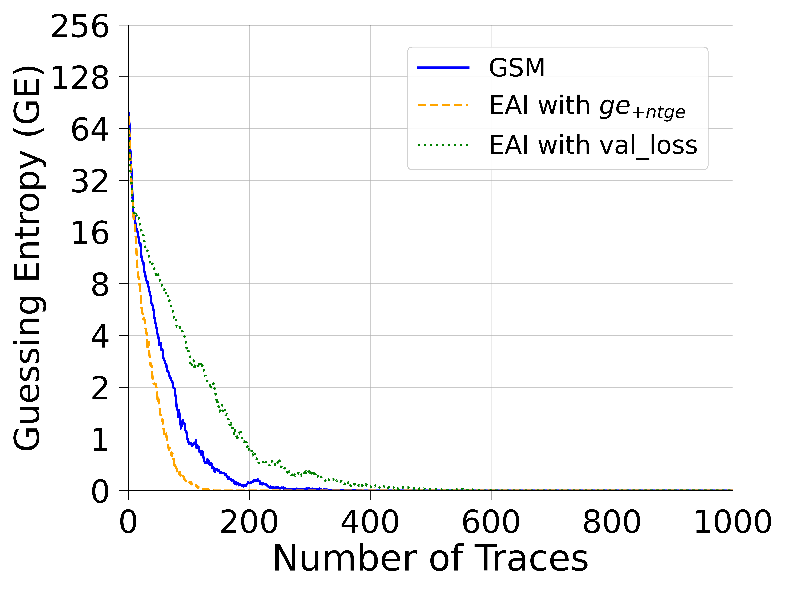
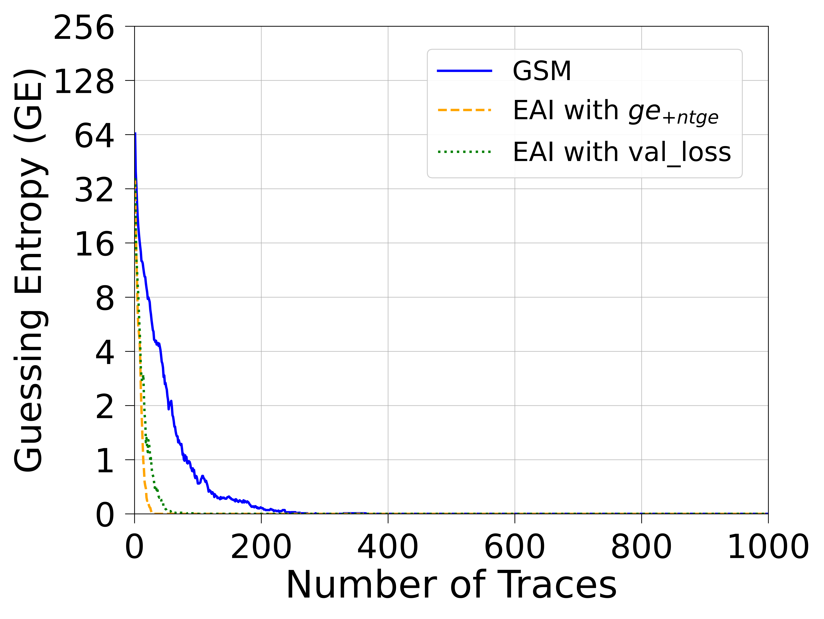
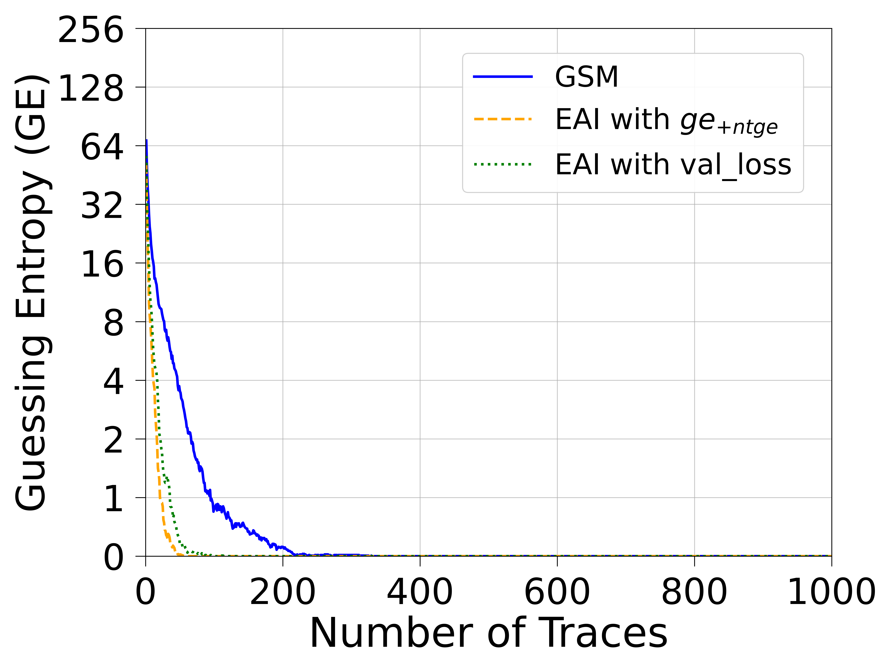
ASCADf (ID)
CNN(ID)
MLP(ID)
CNN&MLP(ID)

Slide 30
NTGE for different algorithms and leakage models
in the ASCON2 Dataset
Algorithm | MLP | CNN | Diverse DNN
GSM | (GE = 15) | (GE 54) | (GE = 40)
EAI with ge_{+ntge} | 977 | (GE = 1) | (GE = 3)
EAI with val_loss | (GE = 34) | (GE = 93) | (GE = 126)
Notes:
Lets see the result for Ascon dataset with 2 bytes
It’s obvious that no method can recover the secret key except for EAI with ge+ntge. And even if CNN and Diverse DNN also cannot recover secret key successfully ，GE is very close to 0.

Slide 31
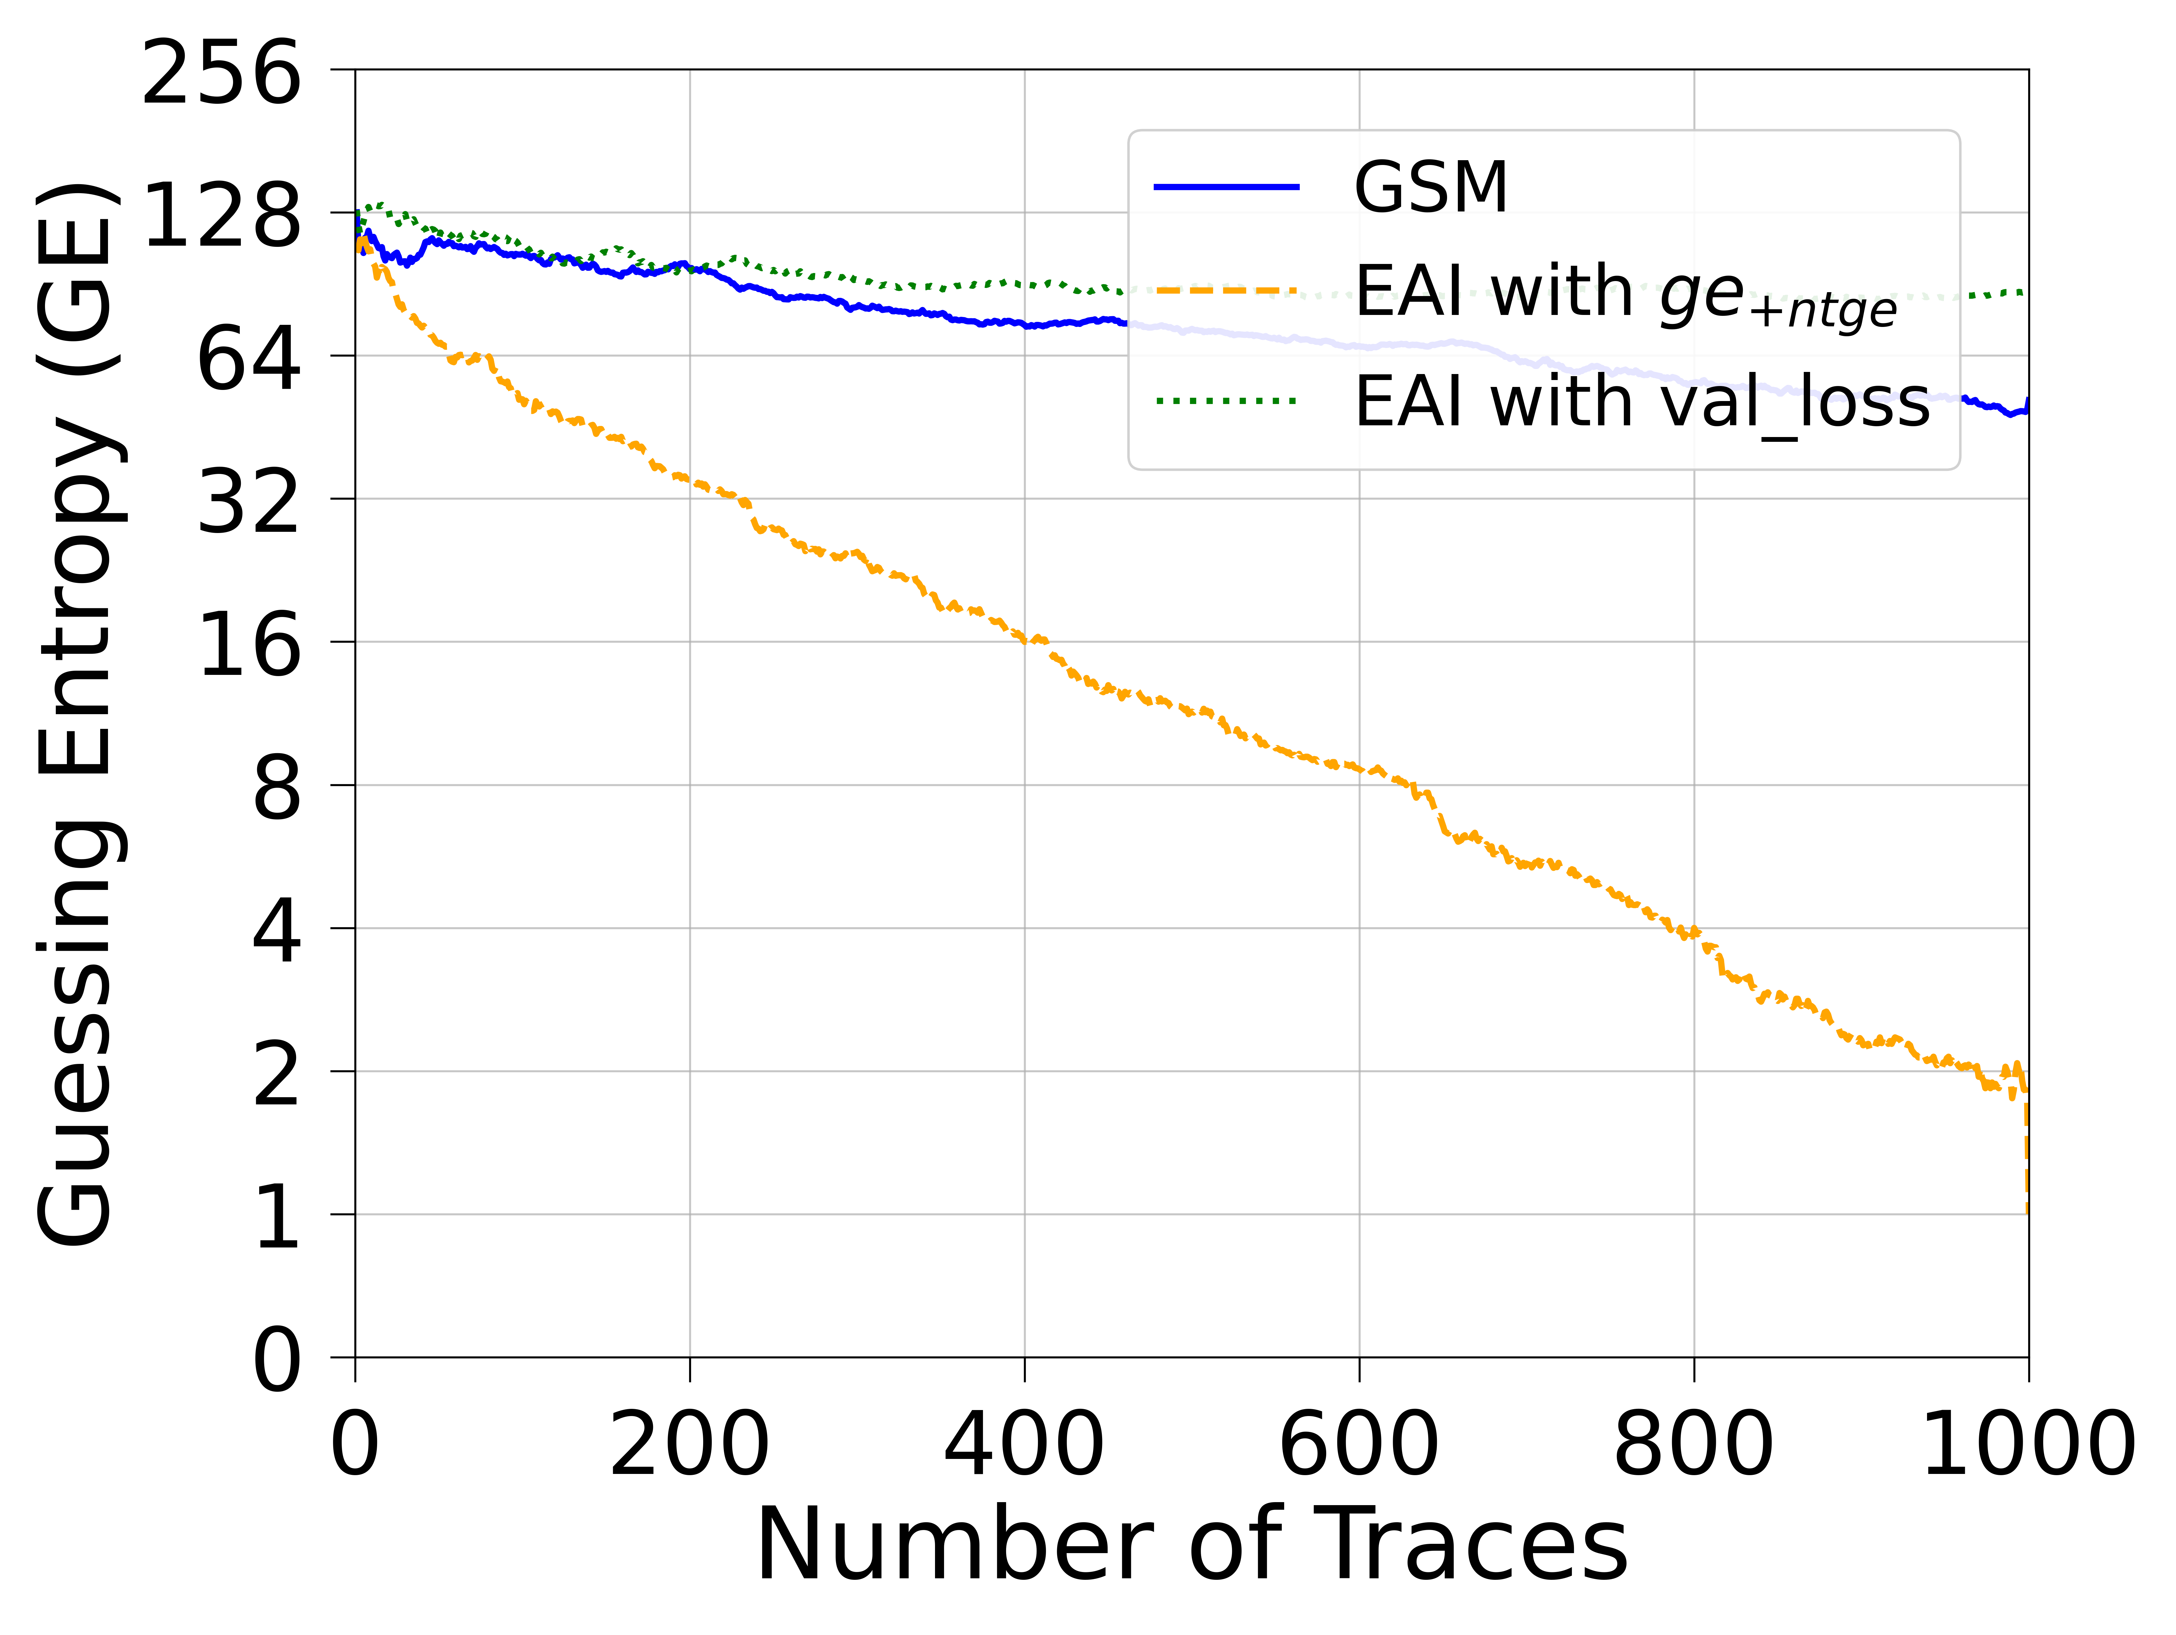
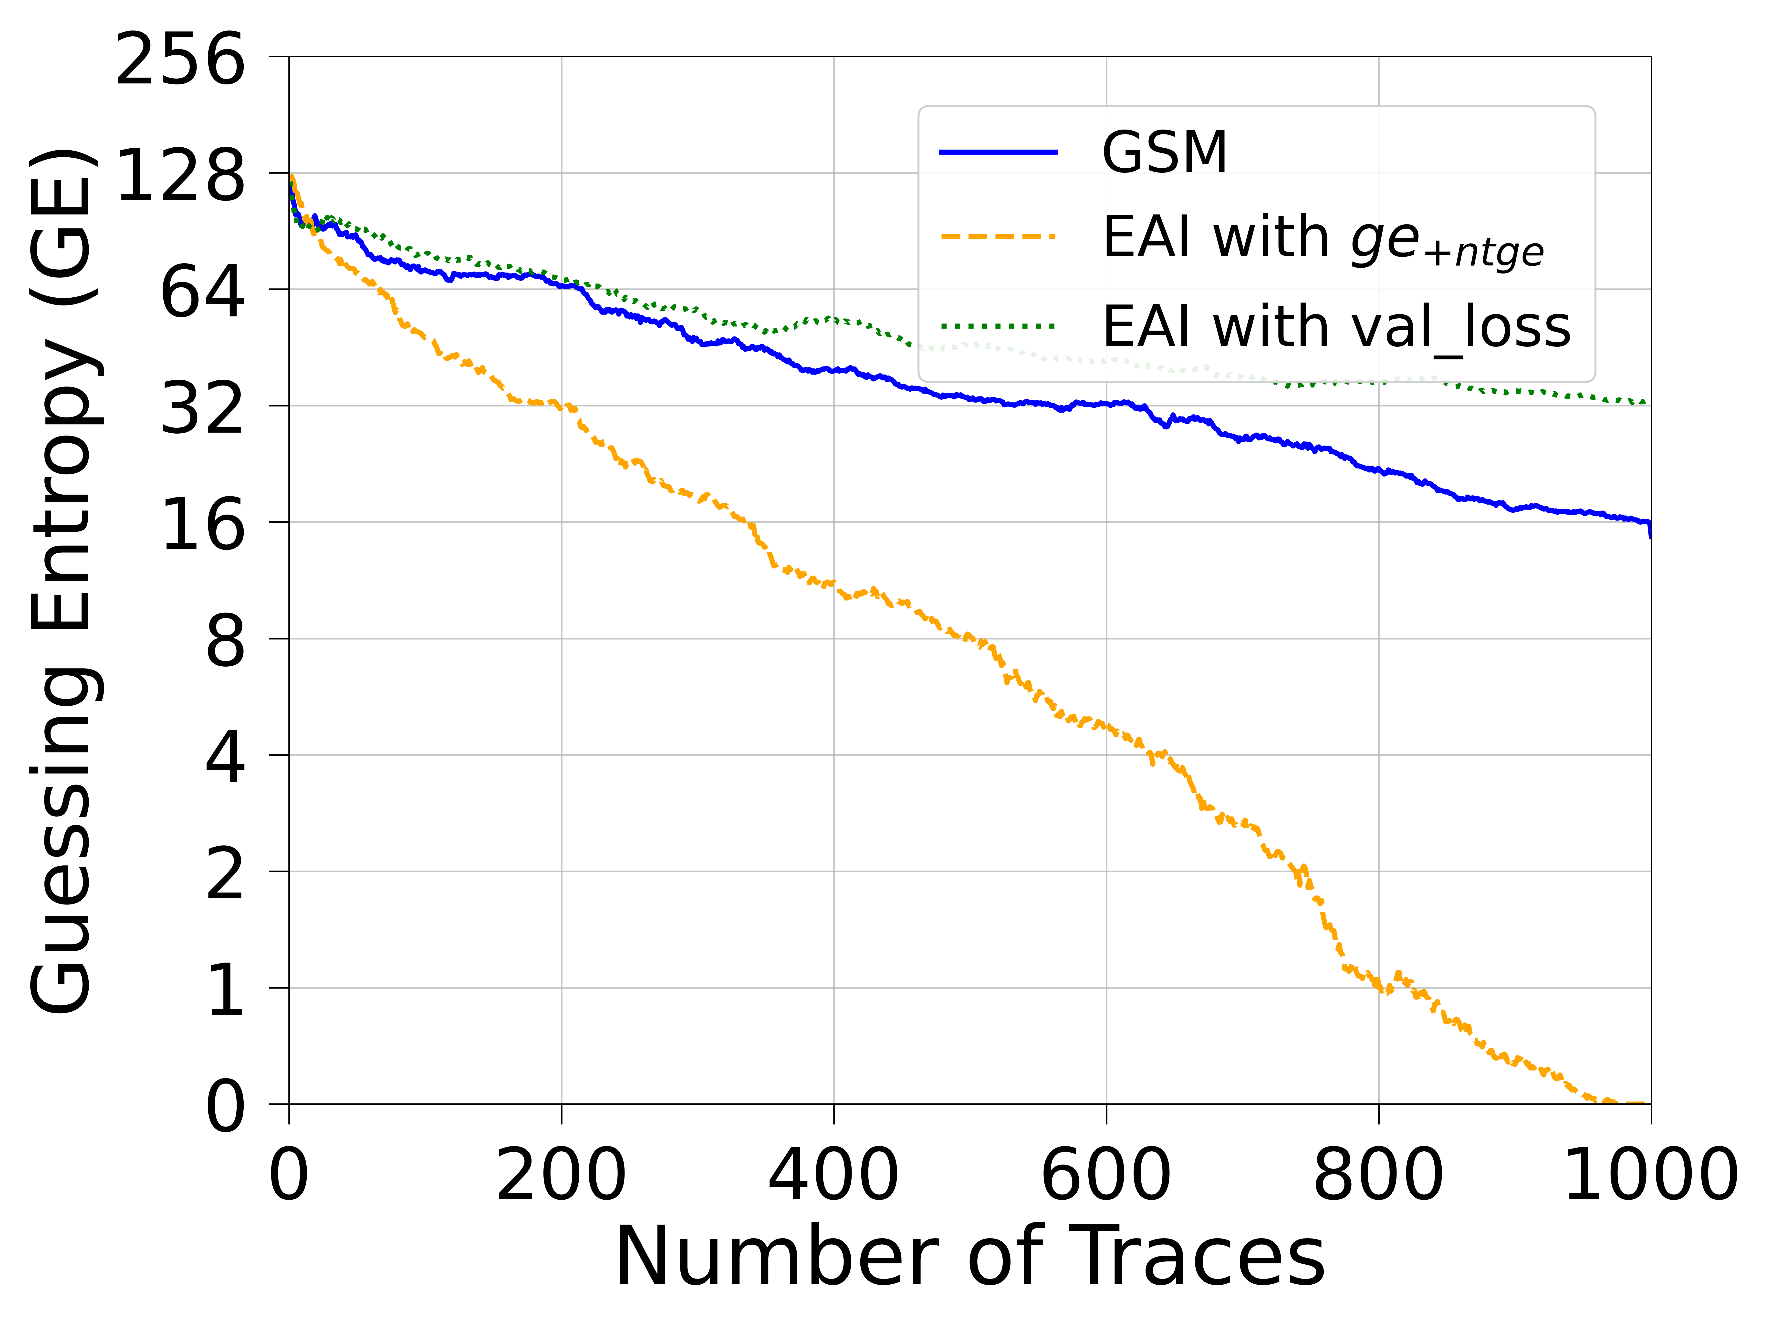
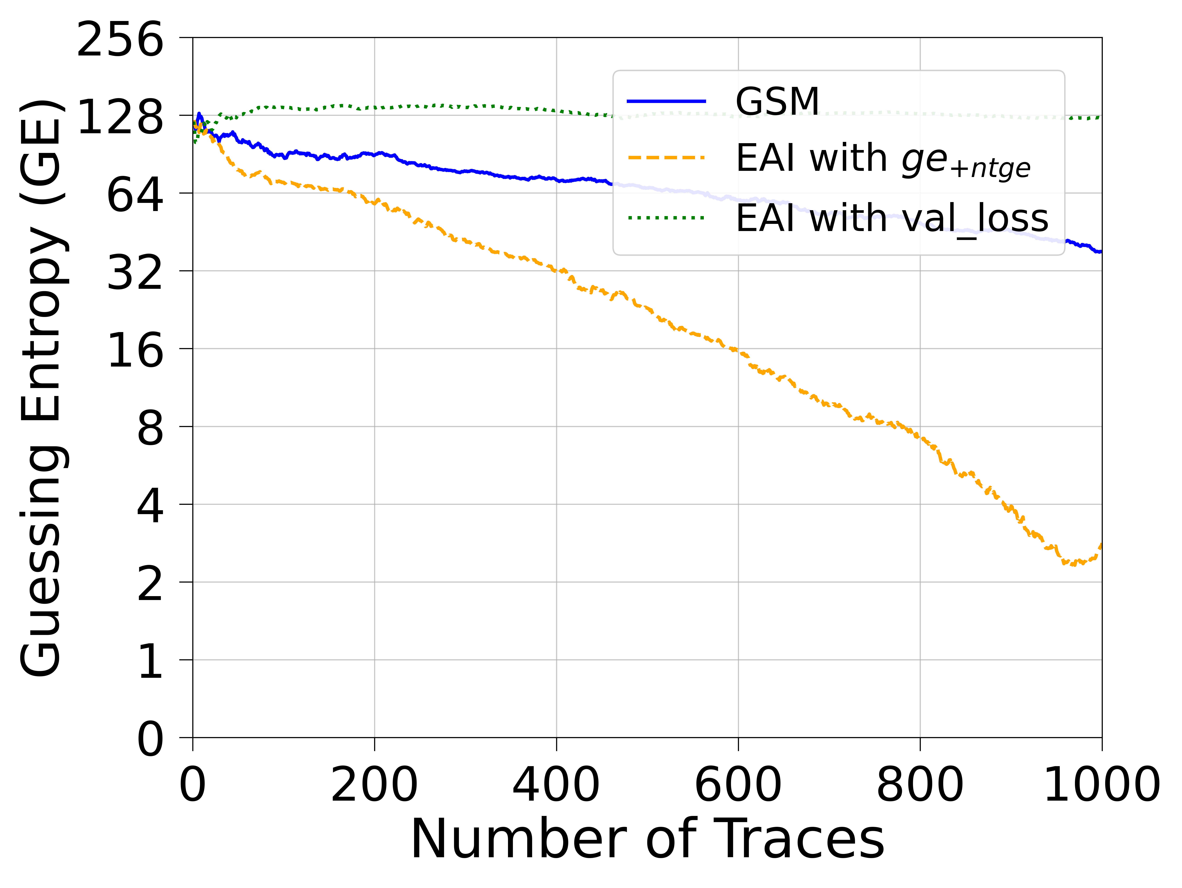
ASCON2
CNN(ID)
MLP(ID)
CNN&MLP(ID)
Notes:
We only evaluate with identity leakage model for this dataset.

Slide 32
NTGE for different algorithms and leakage models
in the AES_HD Dataset
Algorithm | MLP | CNN | Diverse DNN
GSM | 925 | 840 | (GE = 3)
EAI with ge_{+ntge} | 569 | 700 | 456
EAI with val_loss | 998 | (GE = 12) | 662
Notes:
Finally,I will show the result for AES_HD dataset. The best NTGE is almost half of with 456 attack traces when using diverse DNN compared to the traditional GSM which uses 840 attack traces when using CNN.
These highlight are sufficient to show that EAI with ge+ntge is effective in finding well-performing DNNs.

Slide 33
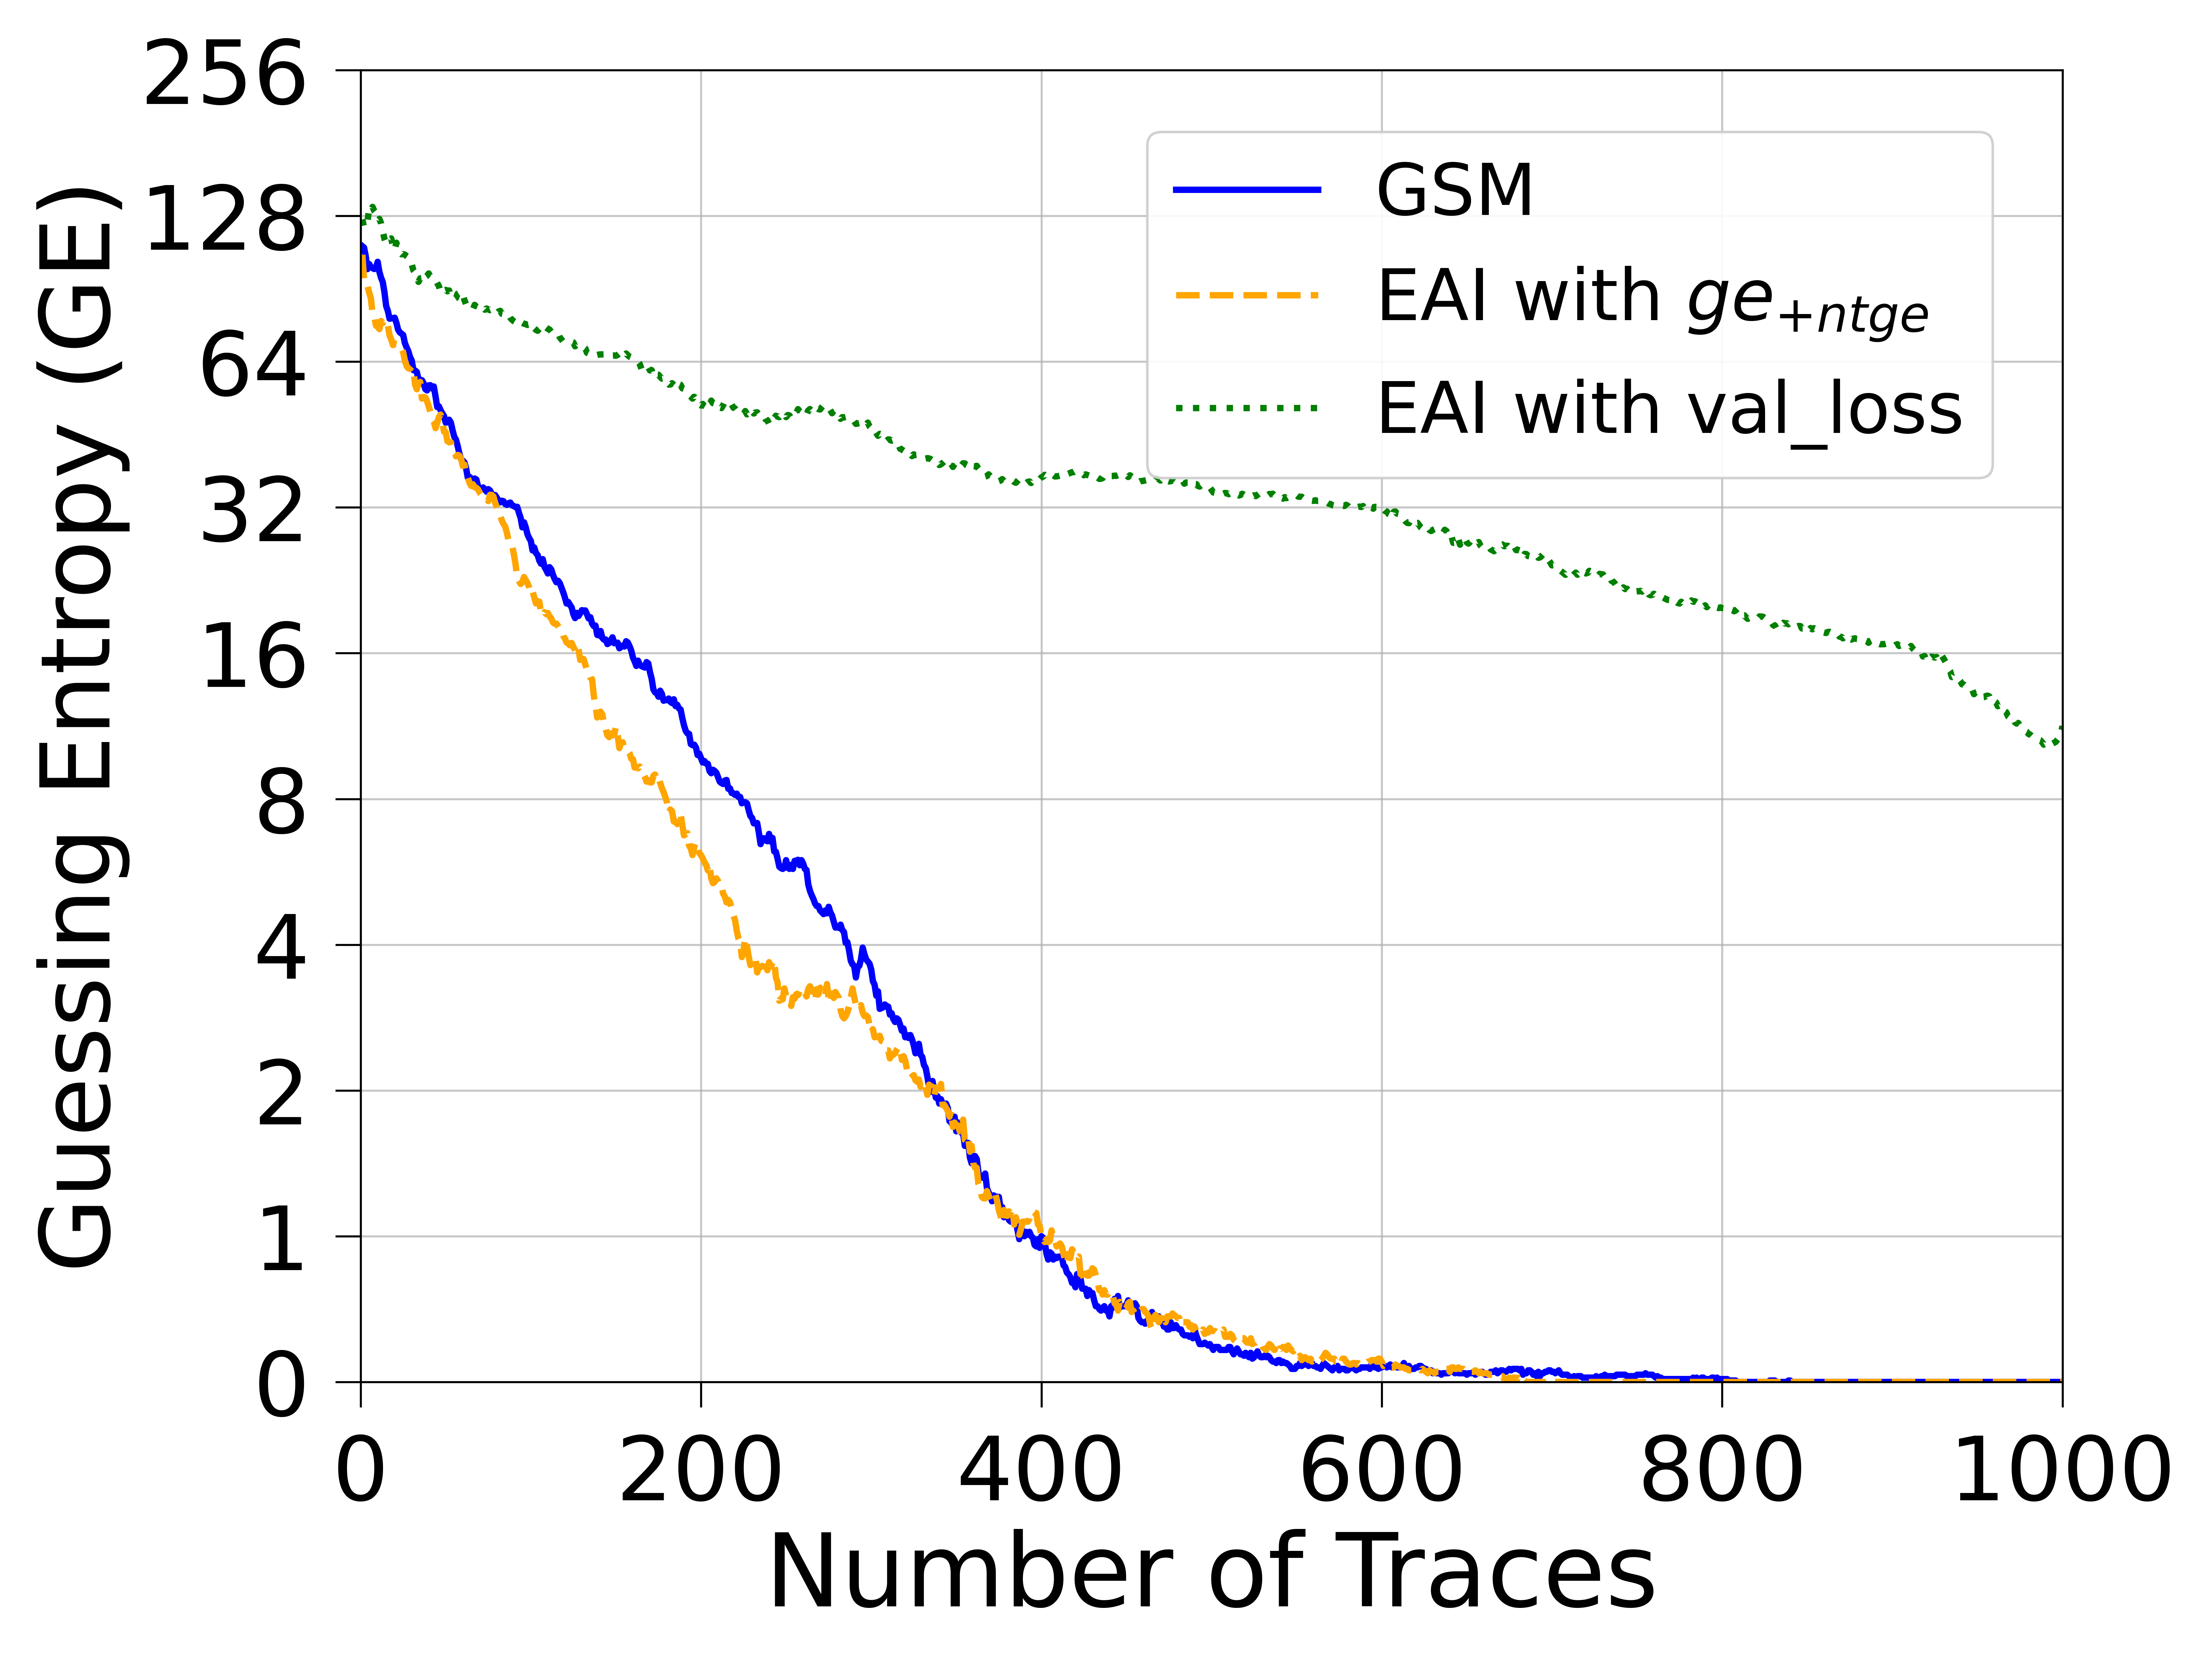
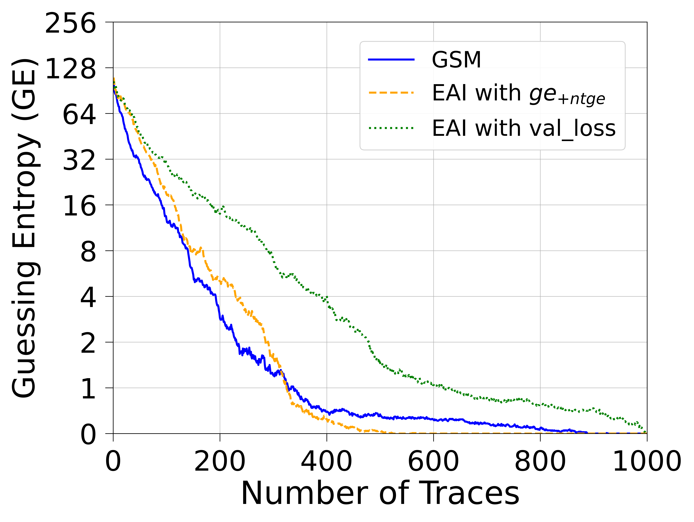
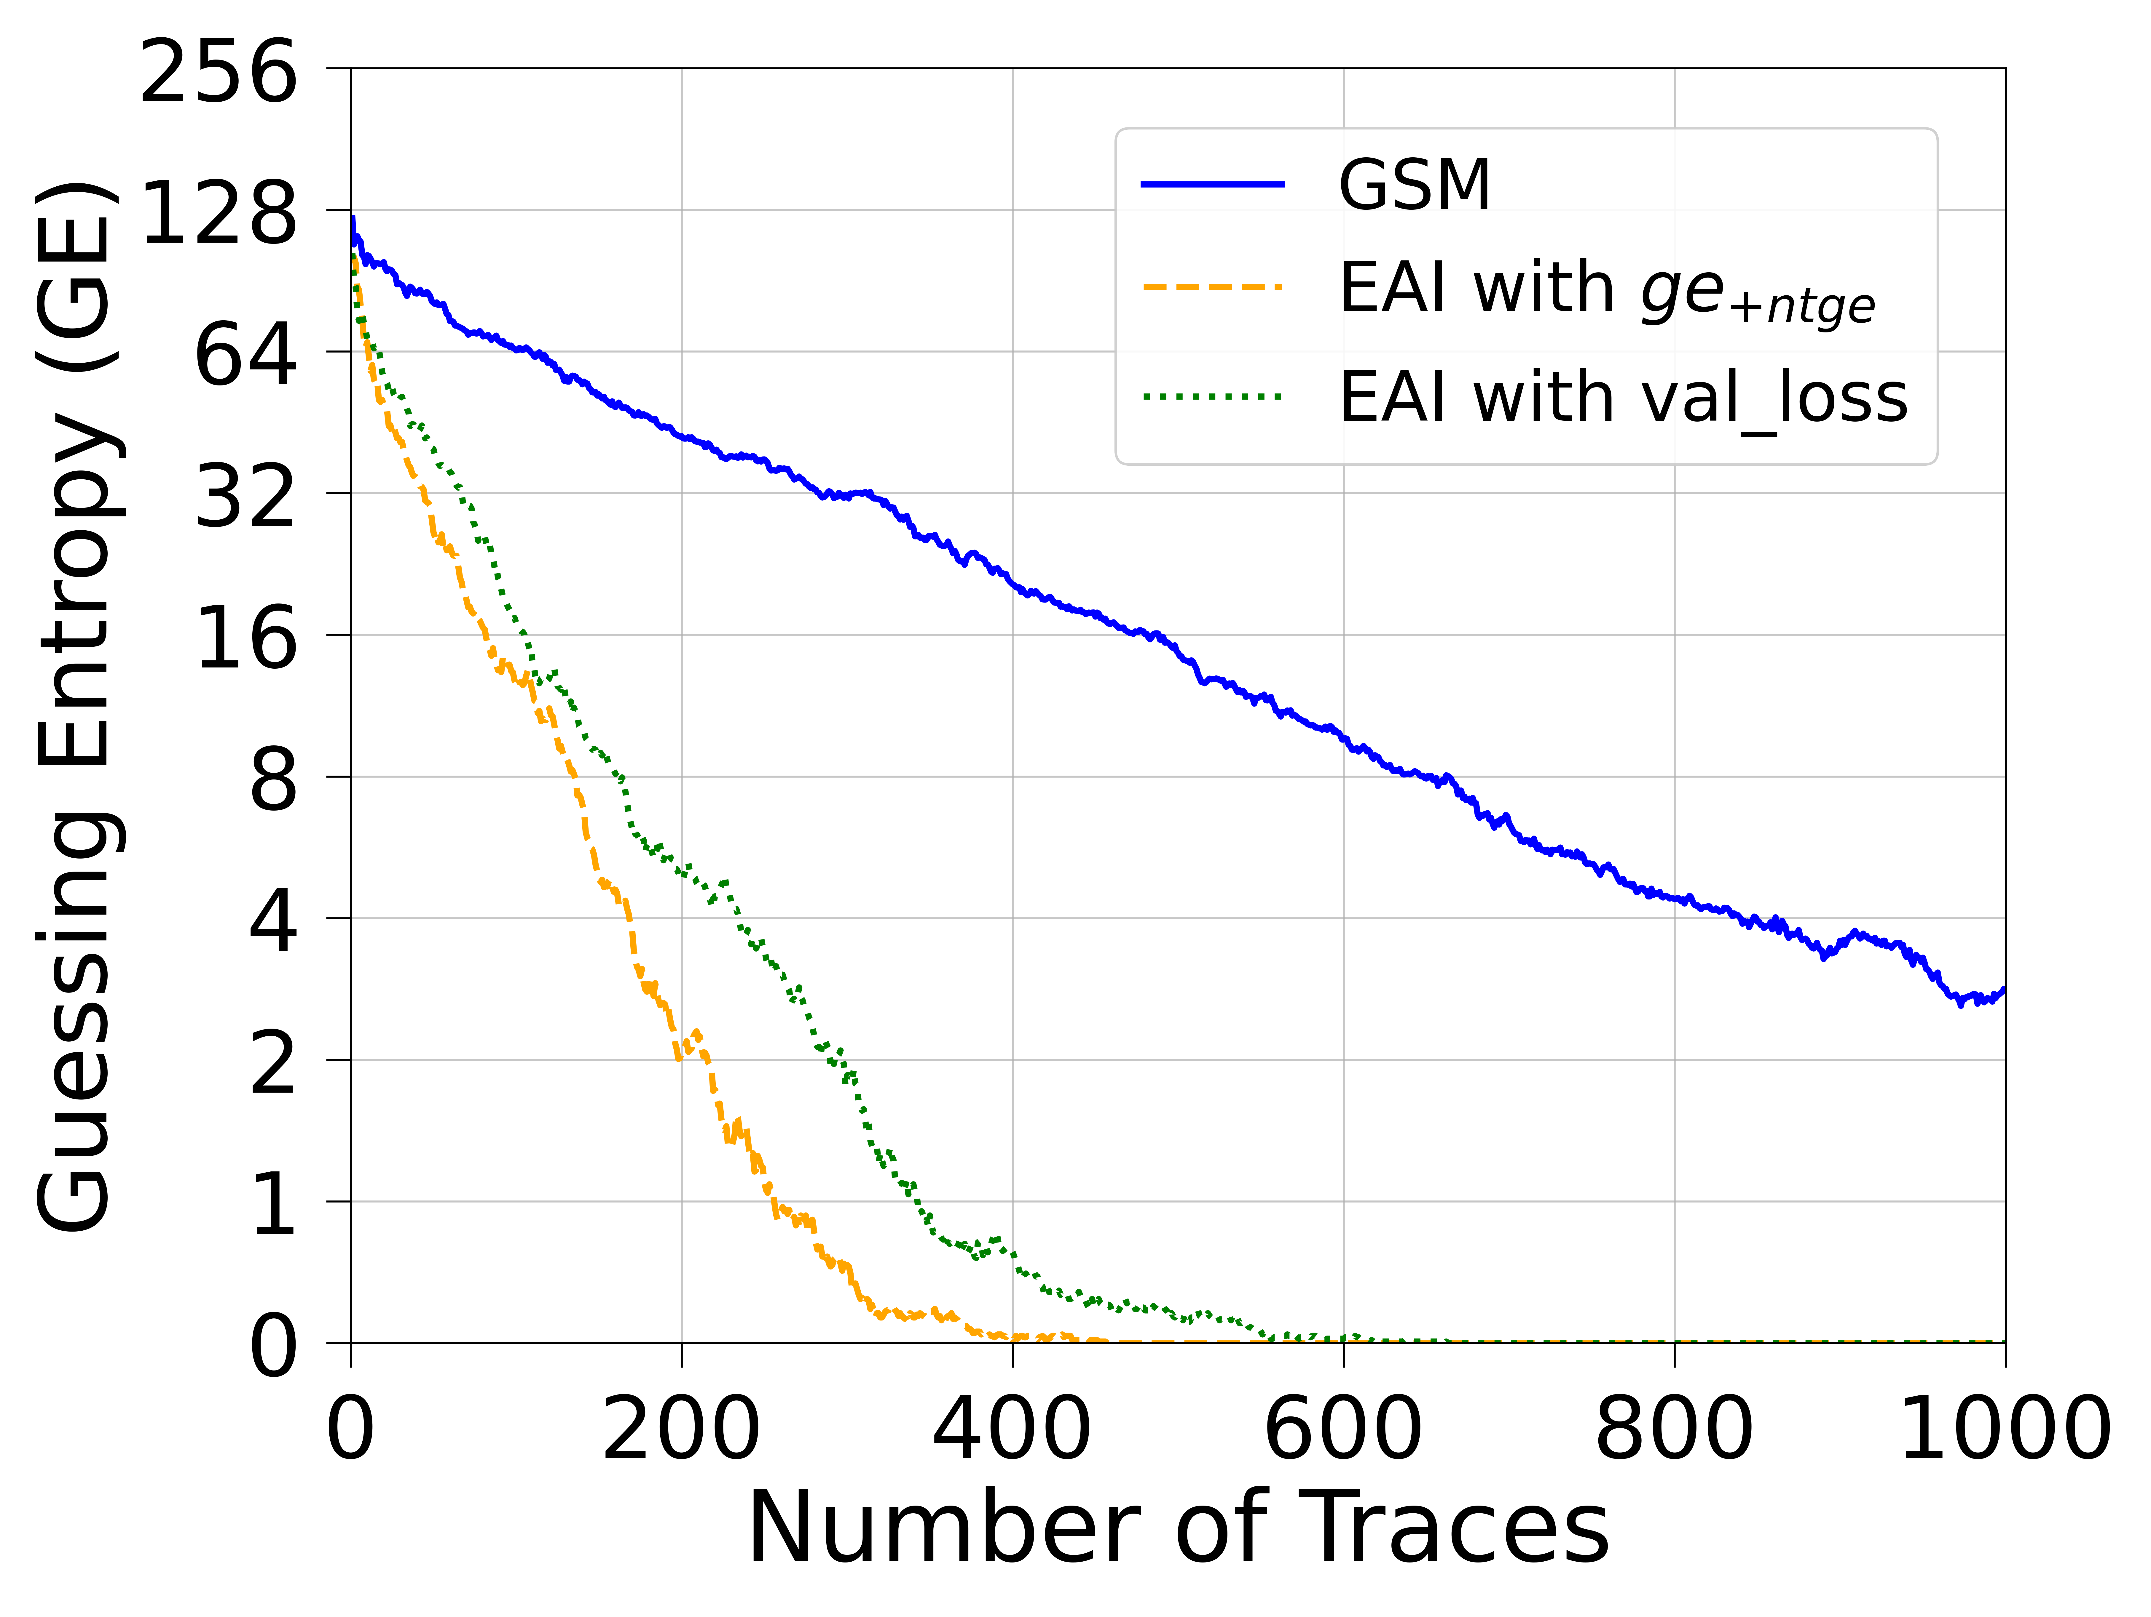
AES_HD
CNN(ID)
MLP(ID)
CNN&MLP(ID)
Notes:
For this dataset, We also only evaluate with identity leakage model

Slide 34
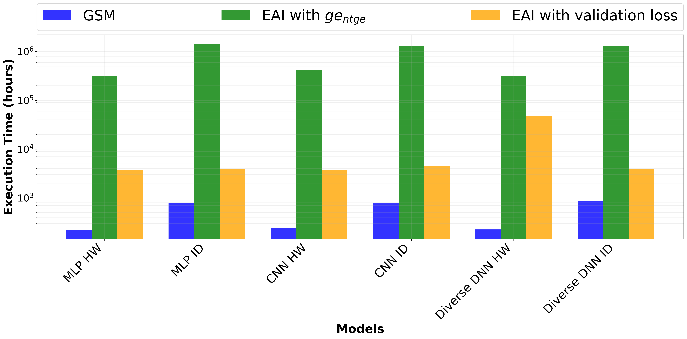
Limitation
Notes:
However, it requires a longer time when executing EAI compared to GSM, as shown in Figure.
This is as expected since GSM only needs to select the top few models and execute the attack phase, but EAI will need to compute the fitness function for different ensembles over many different generations.

Slide 35
Outline
Introduction
Evolutionary Avengers Initiative (EAI)
Initialization
Evaluation & Elitism
Genetic Operations
Experiments
Future Work

Slide 36
Future Work
Enhance EAI approach by leveraging multifidelity optimization methods to reduce execution times
Develop a novel fitness function for EAI that:
Does not require secret key knowledge
Achieves comparable performance to ge_{+ntge}
Can be applied beyond white-box settings during evaluation

Slide 37
Thank You!
Notes:
Our work opens a new direction for using genetic algorithms in side-channel analysis ensemble selection, providing new ideas for building more efficient attacks and more secure systems.
Thank you for your listening ! I'm happy to answer any questions.

Slide 38
References
Perin, G., Chmielewski, L., Picek, S.: Strength in Numbers: Improv-ing Generalization with Ensembles in Machine Learning-based ProfiledSide-channel Analysis. IACR Trans. Cryptogr. Hardw. Embed. Syst.2020(4), 337–364 (2020). https://doi.org/10.13154/TCHES.V2020.I4.337-364,https://doi.org/10.13154/tches.v2020.i4.337-364
Rezaeezade, A., Basurto-Becerra, A., Weissbart, L., Perin, G.: One for All,All for Ascon: Ensemble-Based Deep Learning Side-Channel Analysis. In:Andreoni, M. (ed.) Applied Cryptography and Network Security Workshops- ACNS 2024 Satellite Workshops, AIBlock, AIHWS, AIoTS, SCI, AAC,SiMLA, LLE, and CIMSS, Abu Dhabi, United Arab Emirates, March 5-8, 2024, Proceedings, Part I. Lecture Notes in Computer Science, vol.14586, pp. 139–157. Springer (2024). https://doi.org/10.1007/978-3-031-61486-6“˙9, https://doi.org/10.1007/978-3-031-61486-6 9
Zaid, G., Bossuet, L., Habrard, A., Venelli, A.: Efficiency through Di-versity in Ensemble Models applied to Side-Channel Attacks - A CaseStudy on Public-Key Algorithms -. IACR Trans. Cryptogr. Hardw. Embed.Syst. 2021(3), 60–96 (2021). https://doi.org/10.46586/TCHES.V2021.I3.60-96,https://doi.org/10.46586/tches.v2021.i3.60-96
Llavata, D., Cagli, E., Eyraud, R., Grosso, V., Bossuet, L.: Deep StackingEnsemble Learning Applied to Profiling Side-Channel Attacks. In: Bhasin, S., Roche, T. (eds.) Smart Card Research and Advanced Applications - 22nd In-ternational Conference, CARDIS 2023, Amsterdam, The Netherlands, Novem-ber 14-16, 2023, Revised Selected Papers. Lecture Notes in Computer Science,vol. 14530, pp. 235–255. Springer (2023). https://doi.org/10.1007/978-3-031-54409-5“˙12, https://doi.org/10.1007/978-3-031-54409-5 12
Wang, H., Dubrova, E.: Tandem deep learning side-channel attack onFPGA implementation of AES. SN Comput. Sci. 2(5), 373 (2021). https://doi.org/10.1007/S42979-021-00755-W, https://doi.org/10.1007/s42979-021-00755-w
Masure, L., Dumas, C., Prouff, E.: A Comprehensive Study of Deep Learn-ing for Side-Channel Analysis. IACR Trans. Cryptogr. Hardw. Embed. Syst.2020(1), 348–375 (2020). https://doi.org/10.13154/TCHES.V2020.I1.348-375,https://doi.org/10.13154/tches.v2020.i1.348-375

Slide 39
Configuration for Each Dataset and Hyperparameters of EAI
 | ASCADf | ASCADr | ASCON2 | ASCON4 | AES_HD
Number of Generations | 50 | 50 | 5 | 5 | 50
Crossover Probability |  | 0.9
Mutation Probability |  | 0.1
Models per Ensemble |  | 10
Number of Ensembles per Generation |  | 30
Models per Tournament |  | 3

Slide 40
NTGE for different algorithms and leakage models
in the ASCADr dataset
Algorithm | MLP |  | CNN |  | Diverse DNN
 | HW | ID | HW | ID | HW | ID
GSM | 548 | 976 | 810 | (GE = 126) | 445 | (GE = 14)
EAI with ge_{+ntge} | 296 | 523 | 619 | (GE = 3) | 257 | 923
EAI with val_loss | (GE = 1) | (GE =185) | (GE =6) | (GE = 178) | (GE = 7) | (GE = 178)

Slide 41
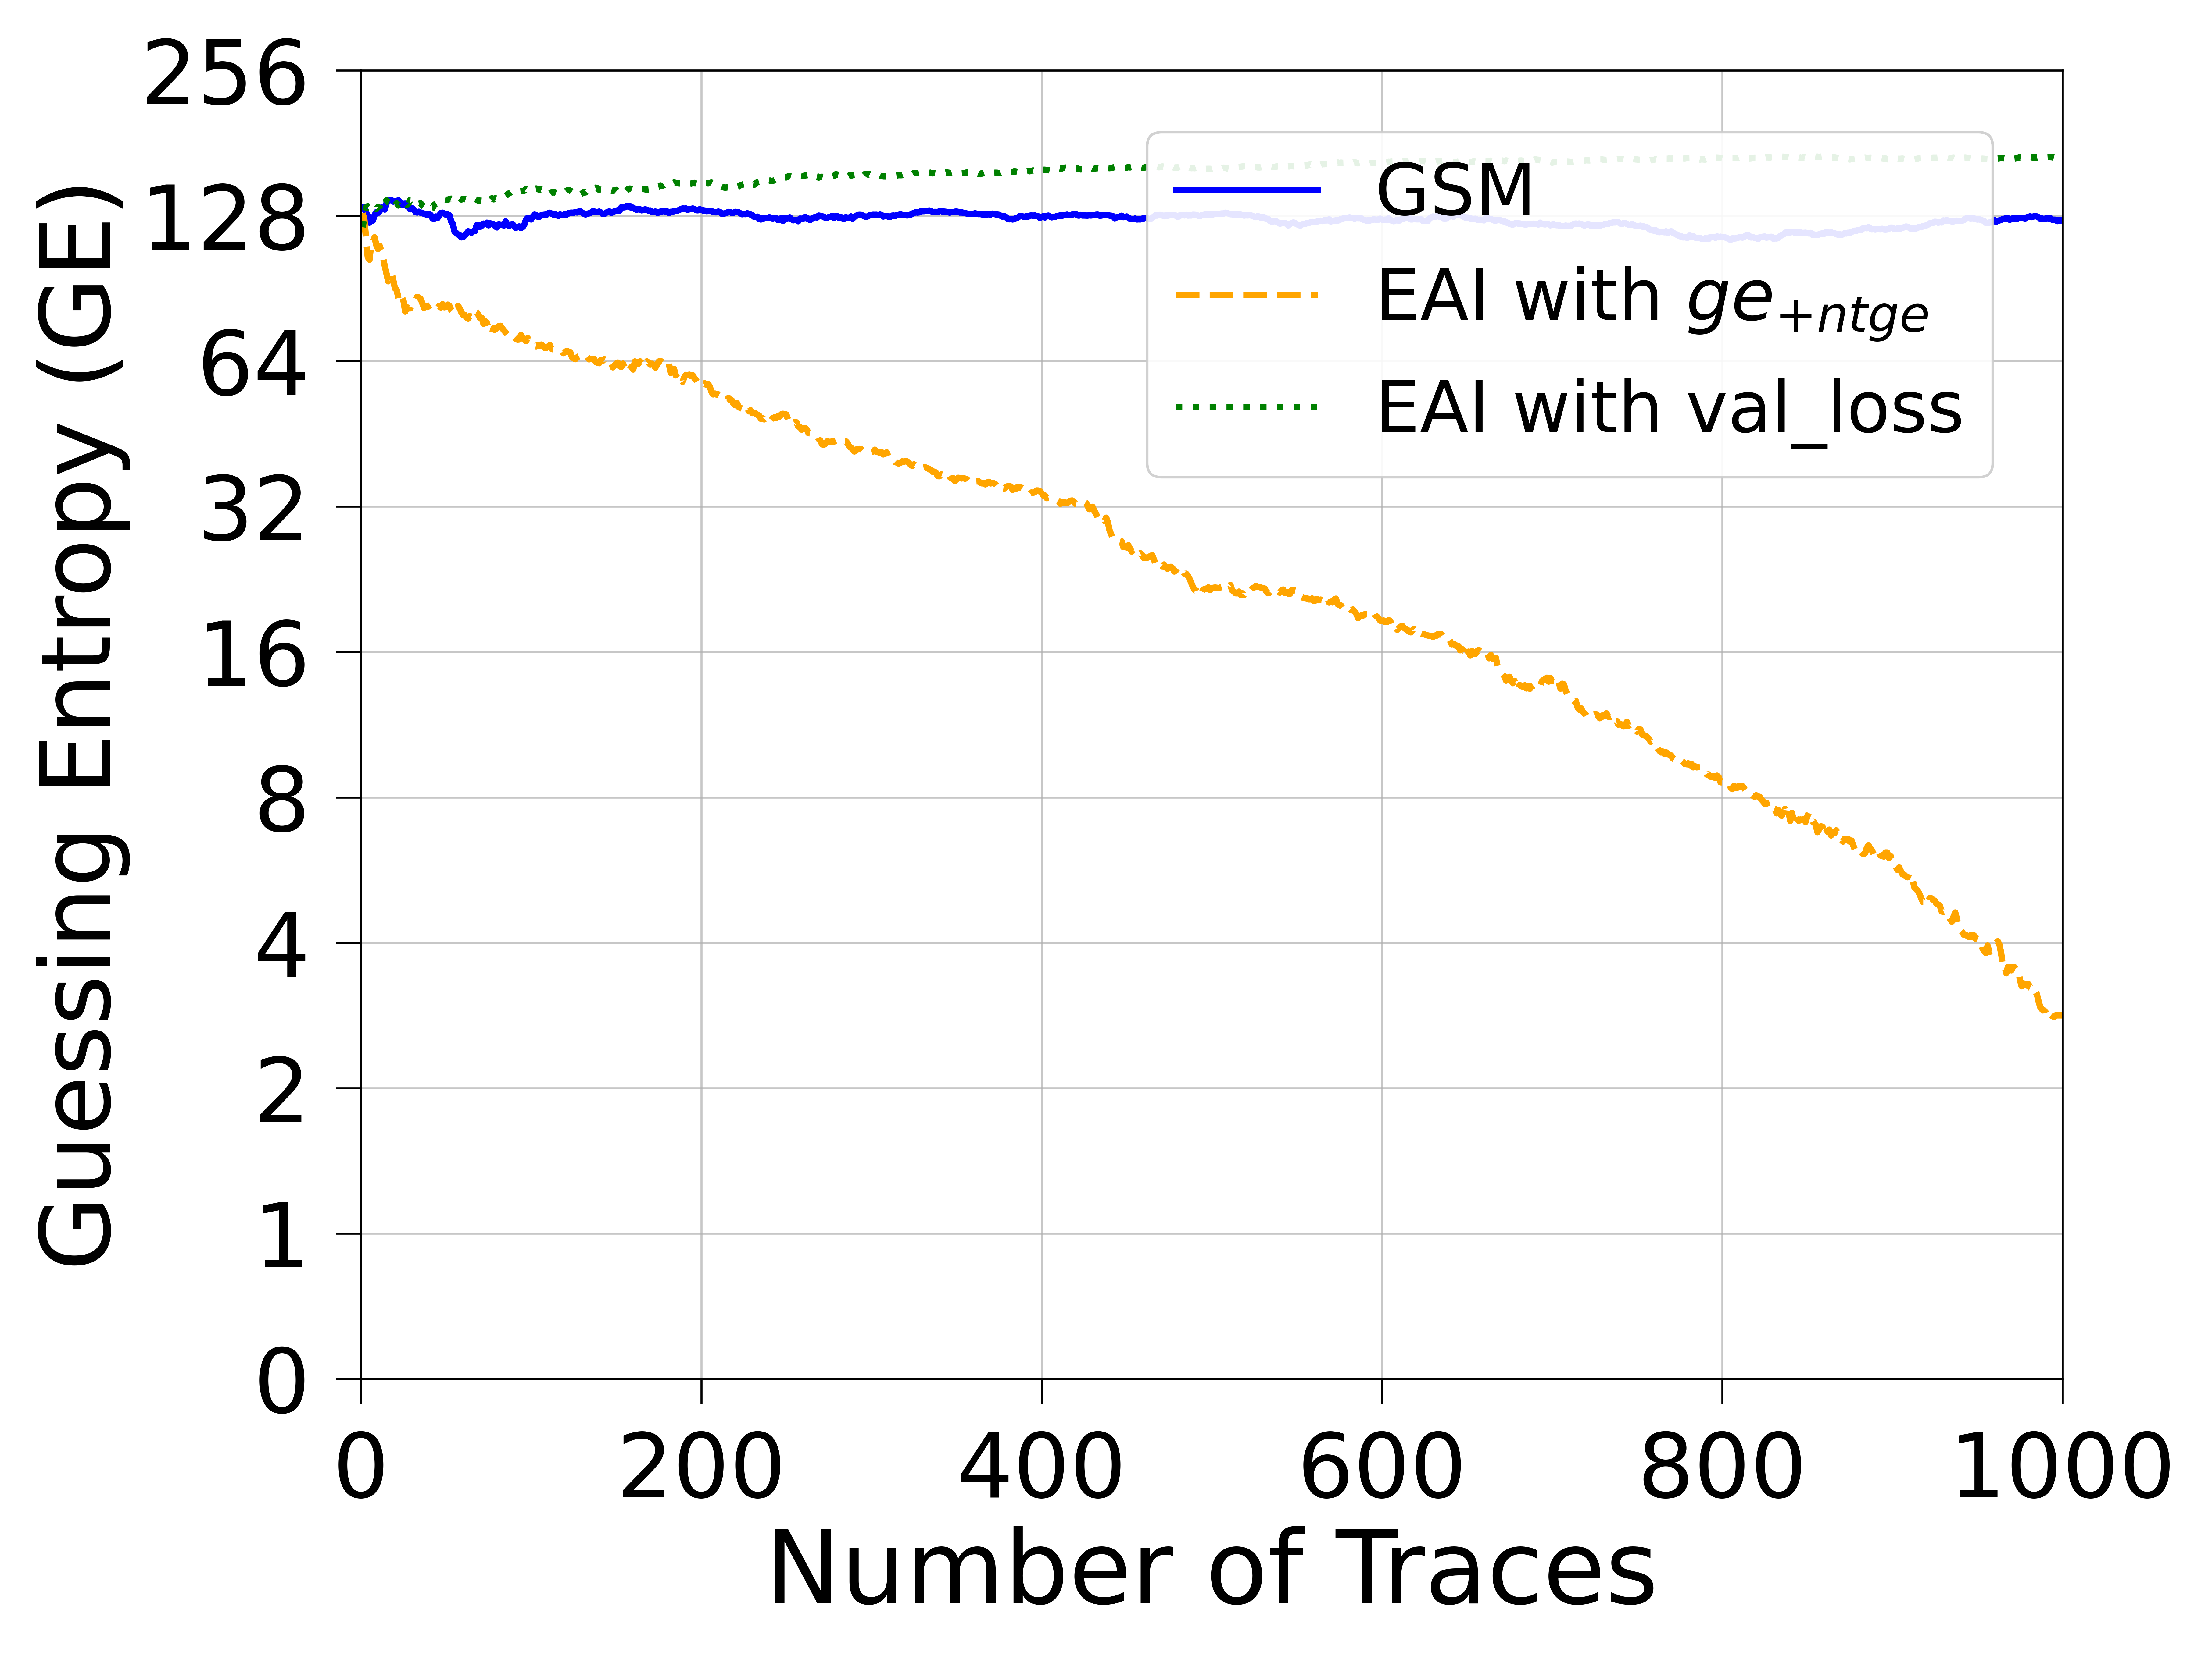
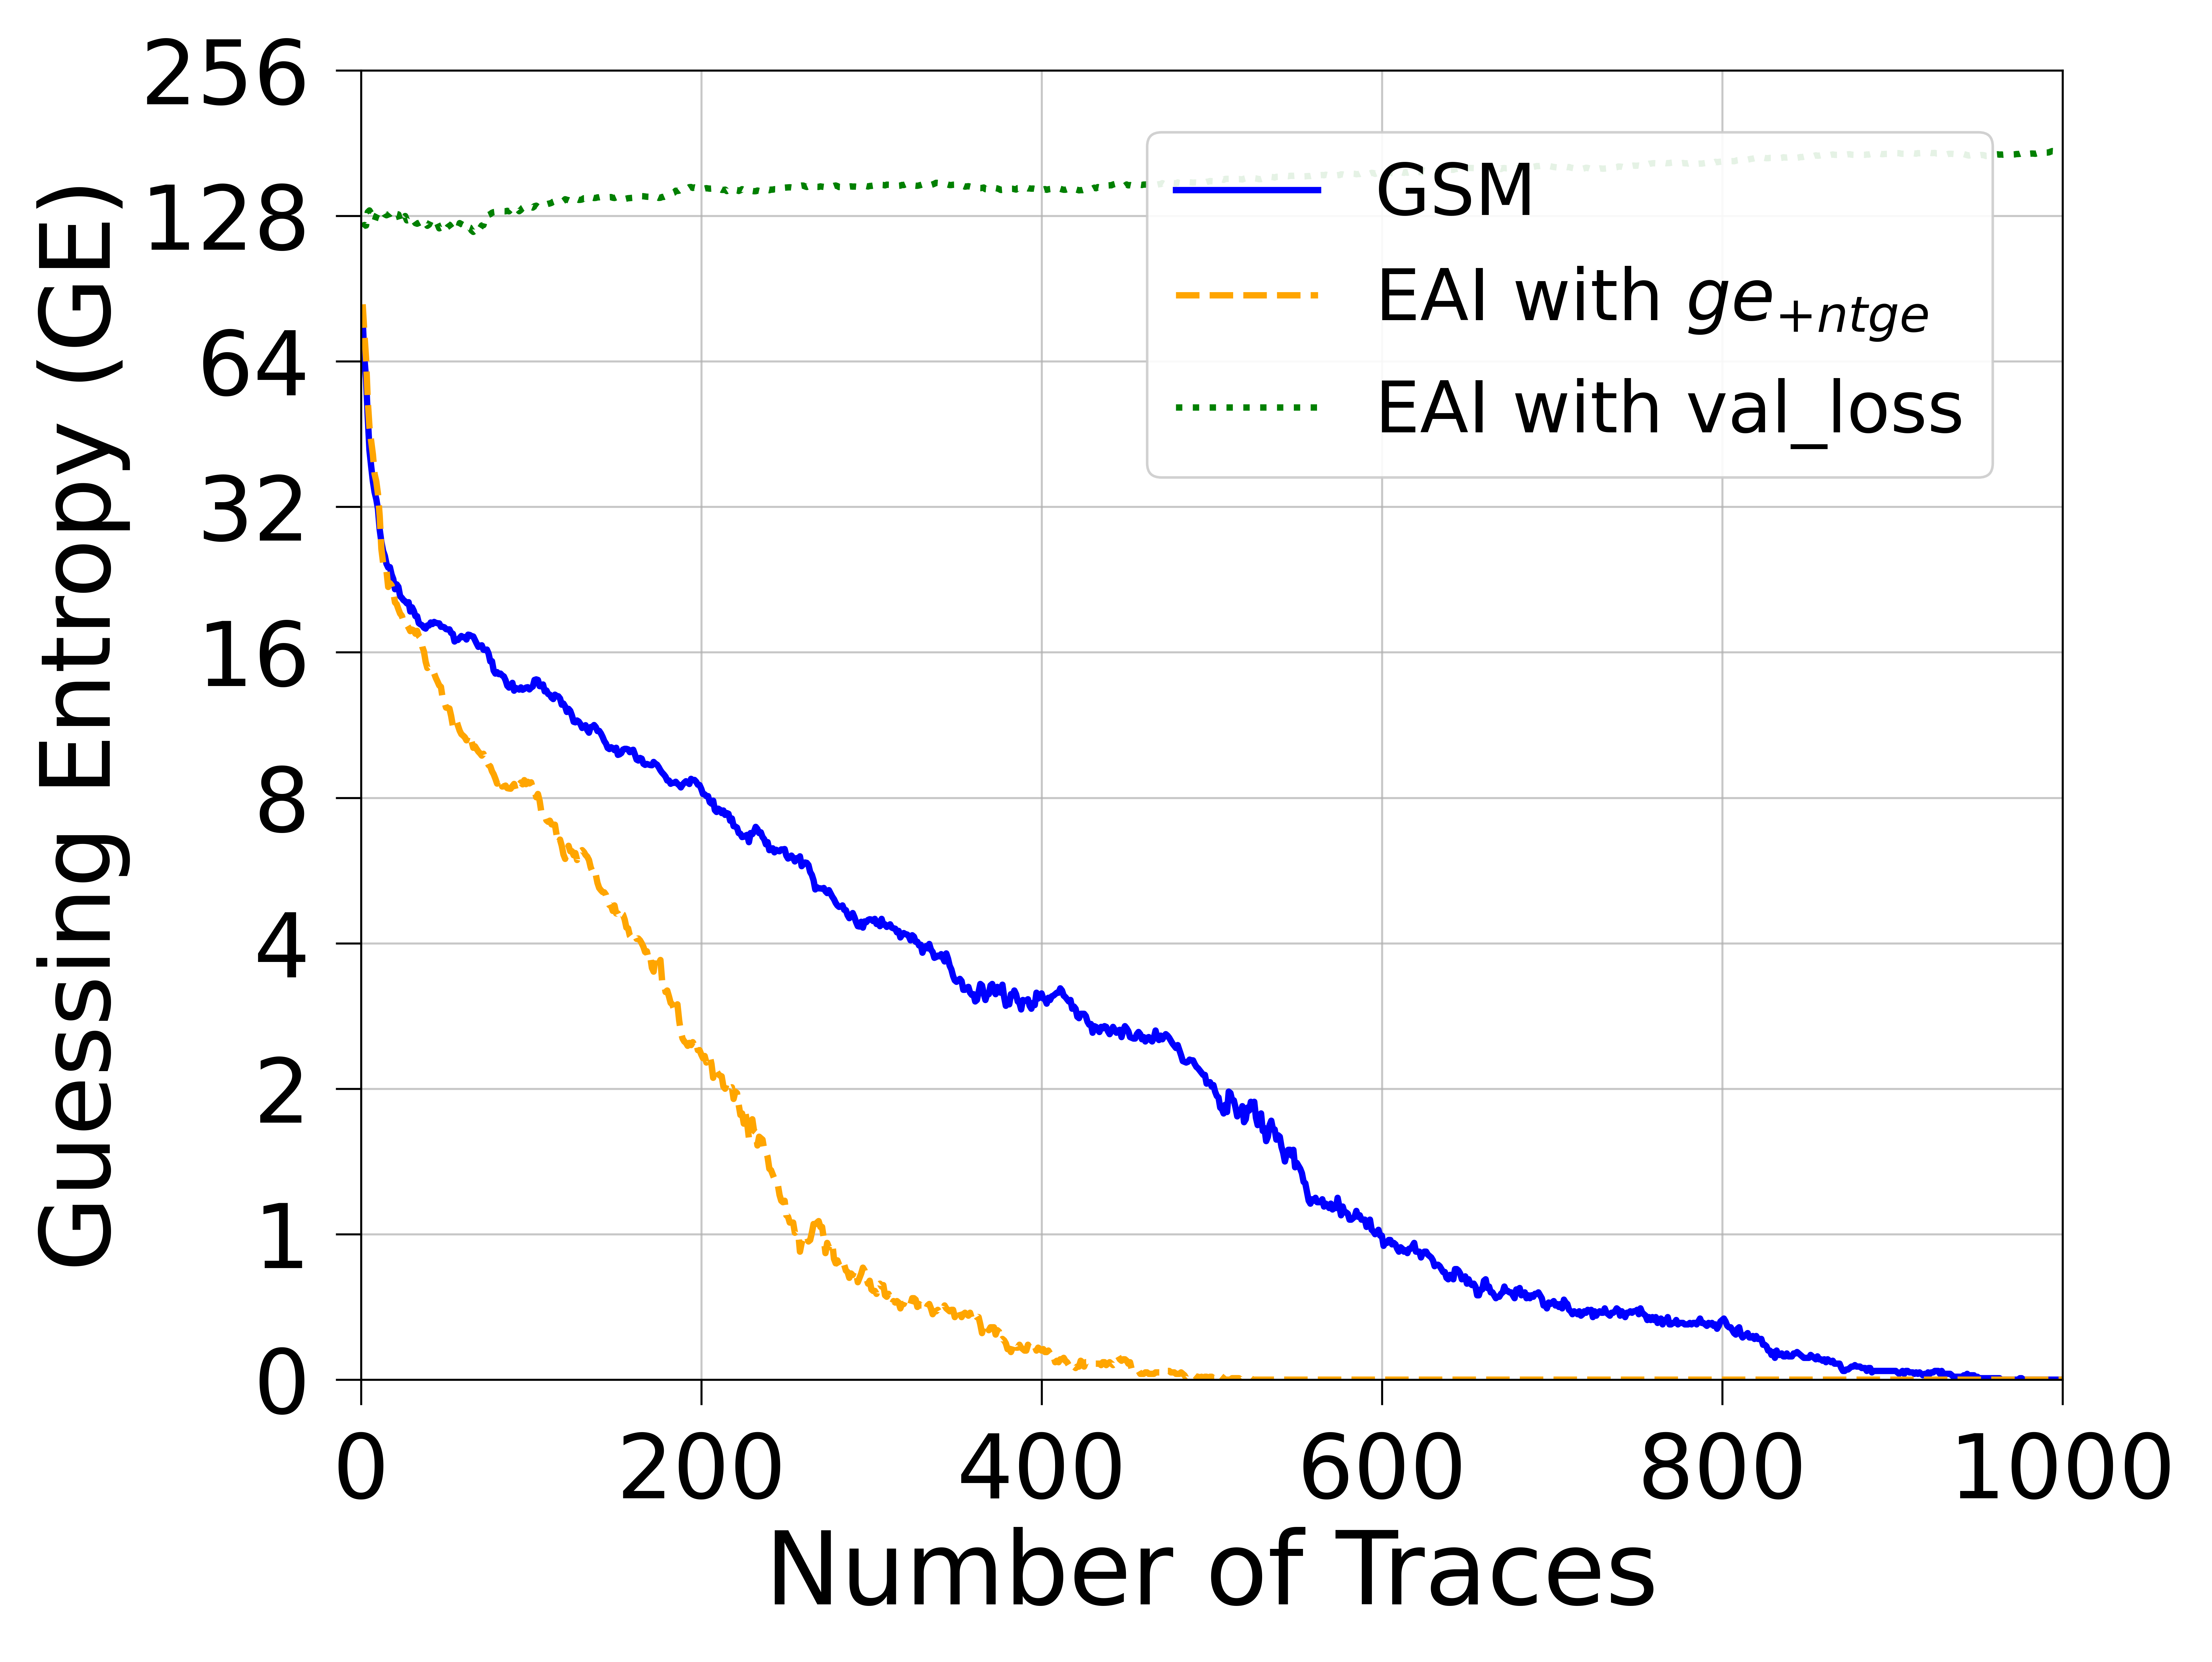
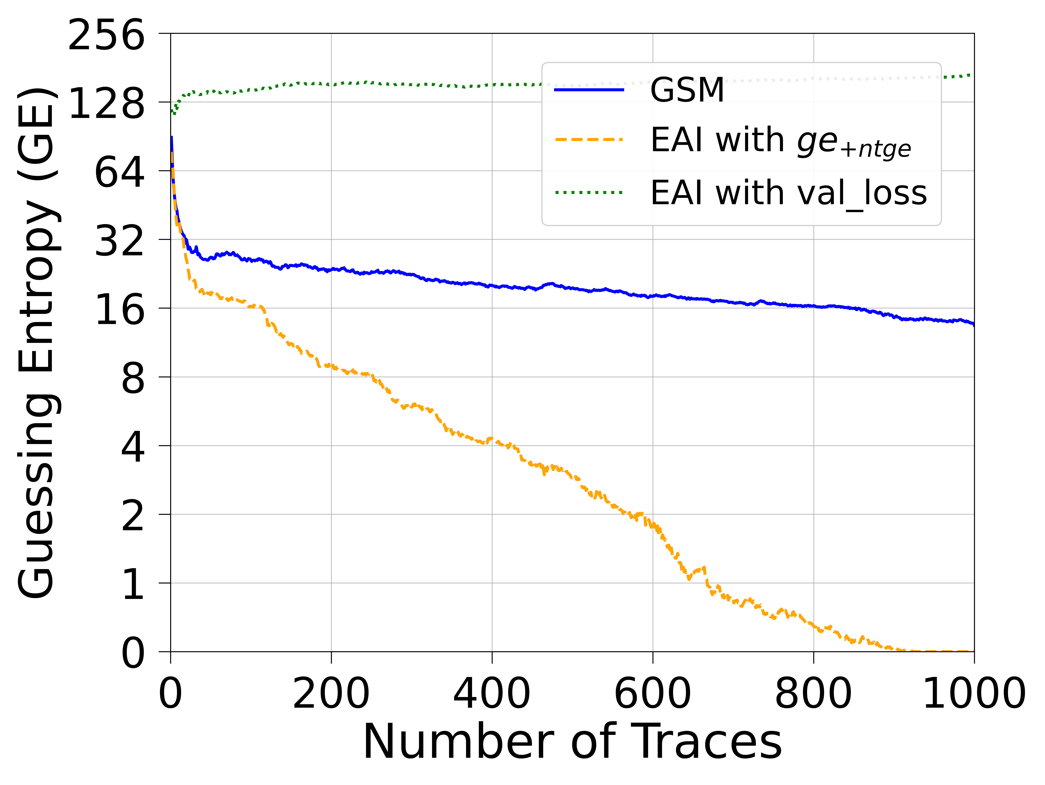
ASCADr (ID)
CNN(ID)
MLP(ID)
CNN&MLP(ID)

Slide 42
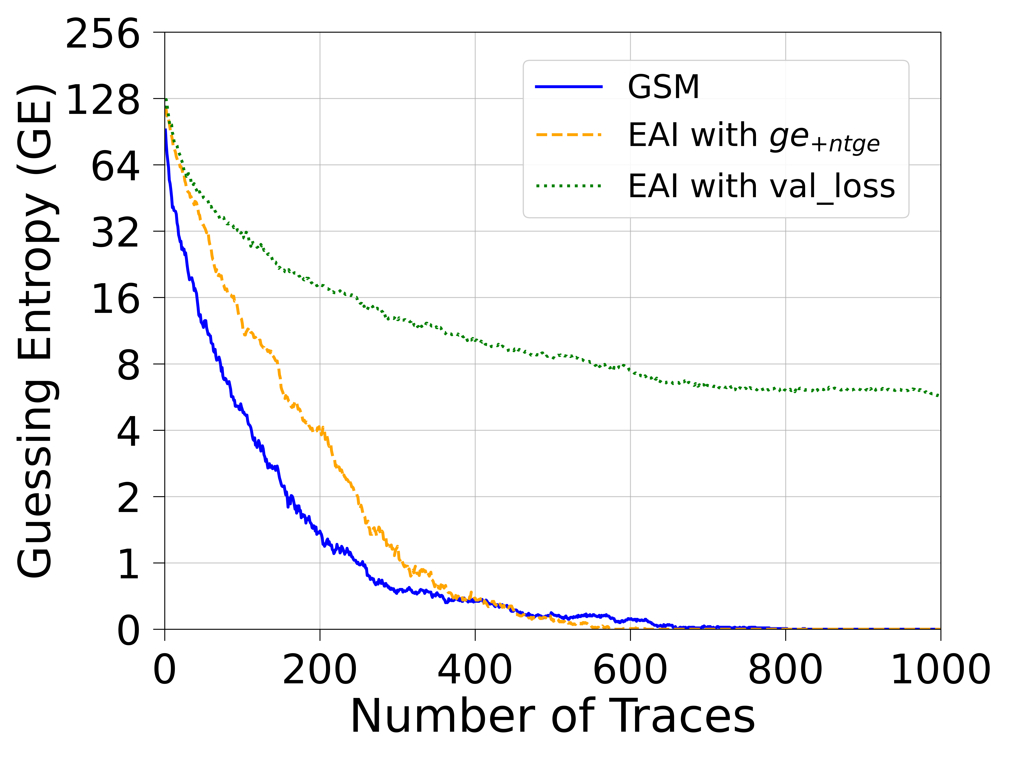
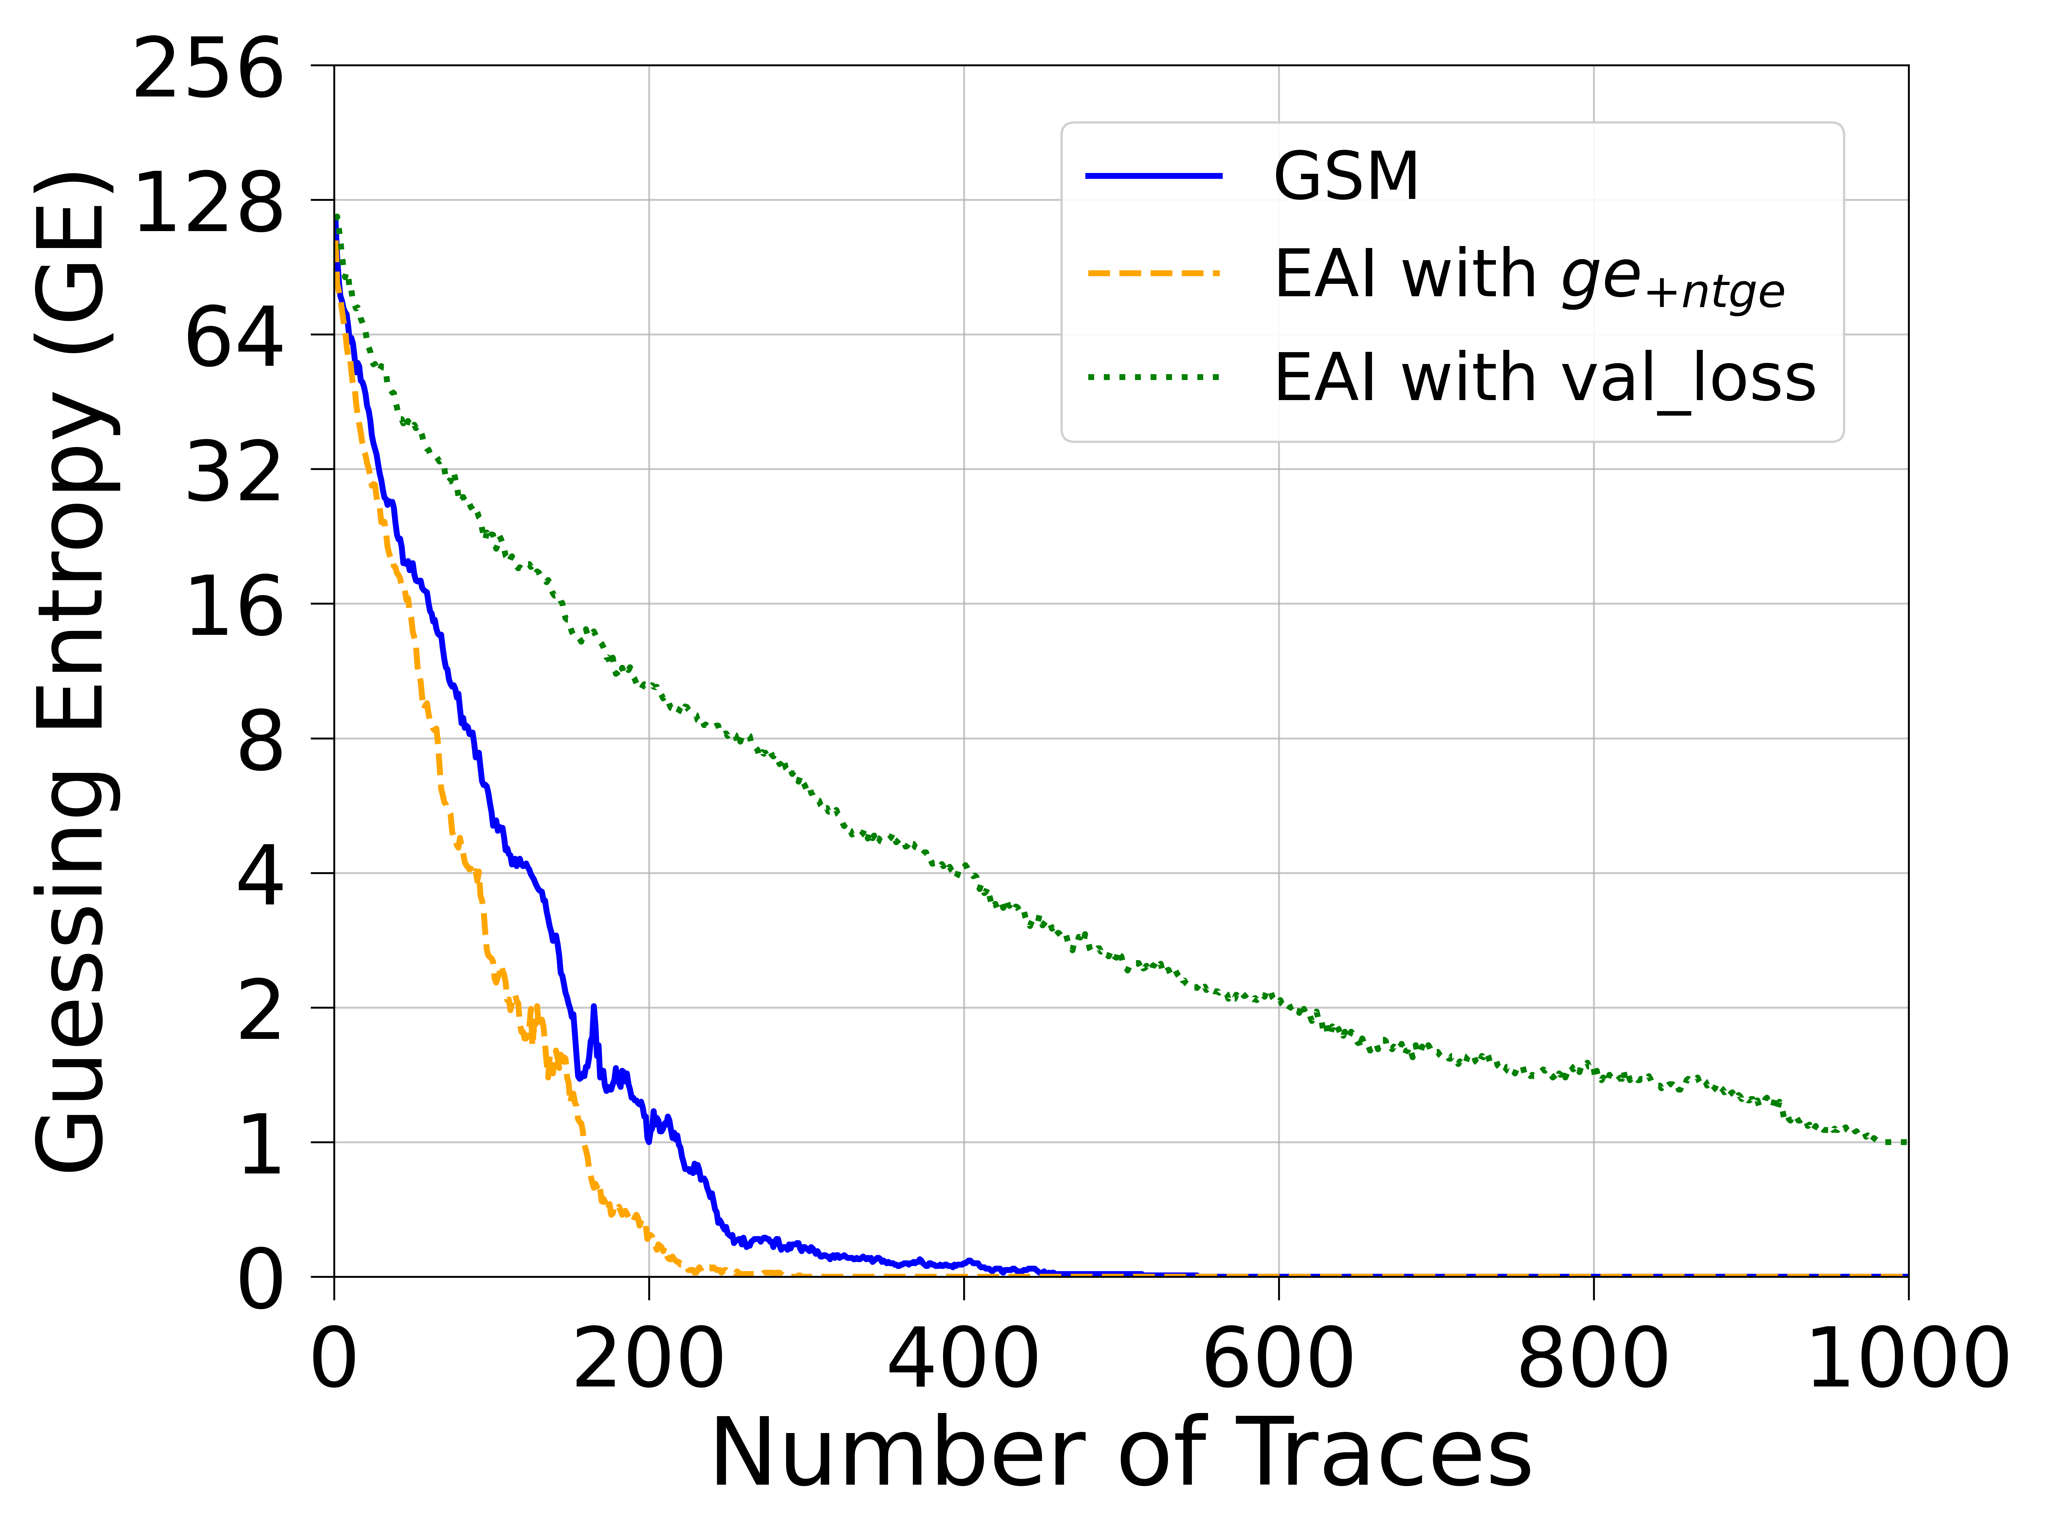
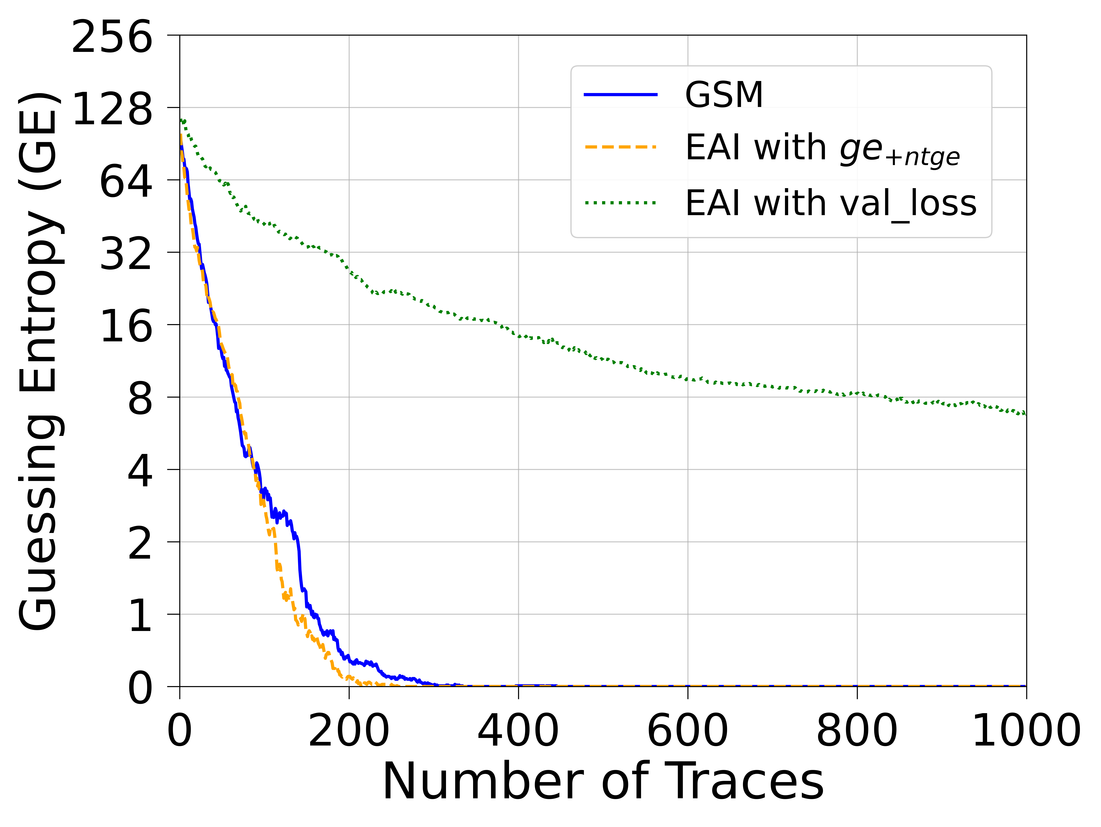
ASCADr (HW)
CNN(HW)
MLP(HW)
MLP&CNN(HW)

Slide 43
NTGE for different algorithms and leakage models
in the ASCON4 Dataset
Algorithm | MLP | CNN | Diverse DNN
GSM | (GE = 140) | (GE = 135) | (GE = 136)
EAI with ge_{+ntge} | (GE = 34) | (GE = 1) | 914
EAI with val_loss | (GE = 220) | (GE = 179) | (GE = 138)

Slide 44
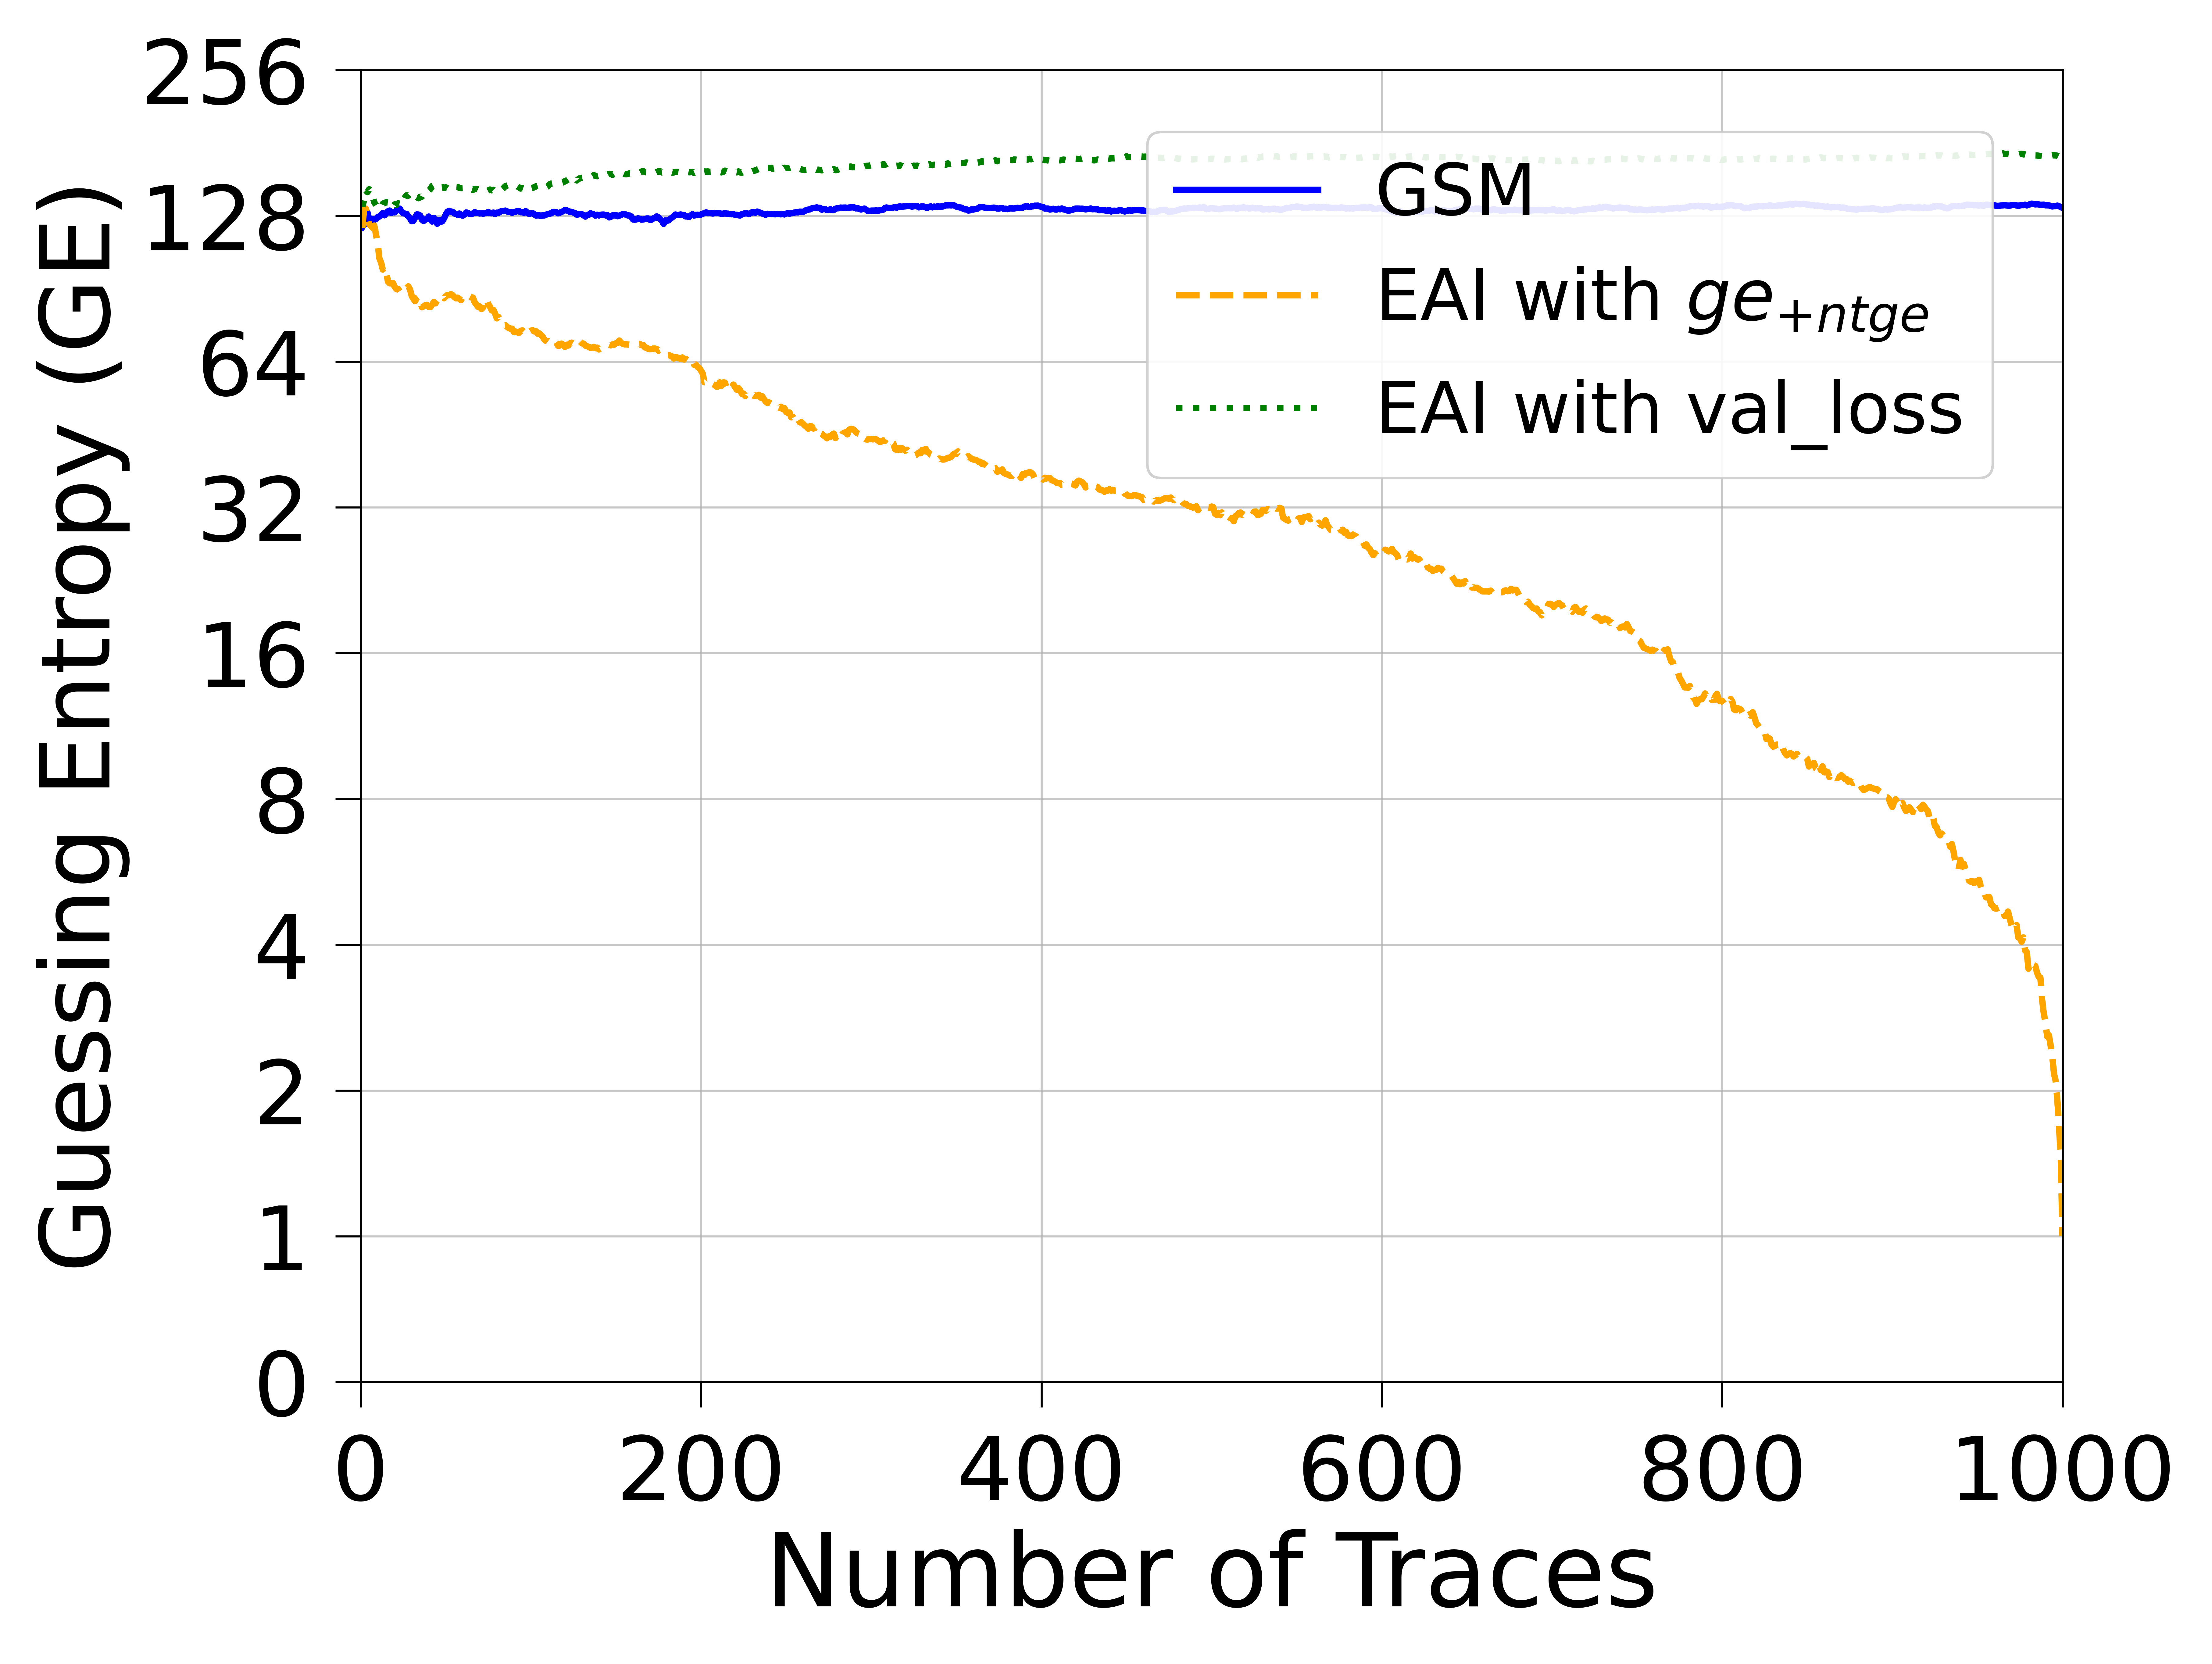
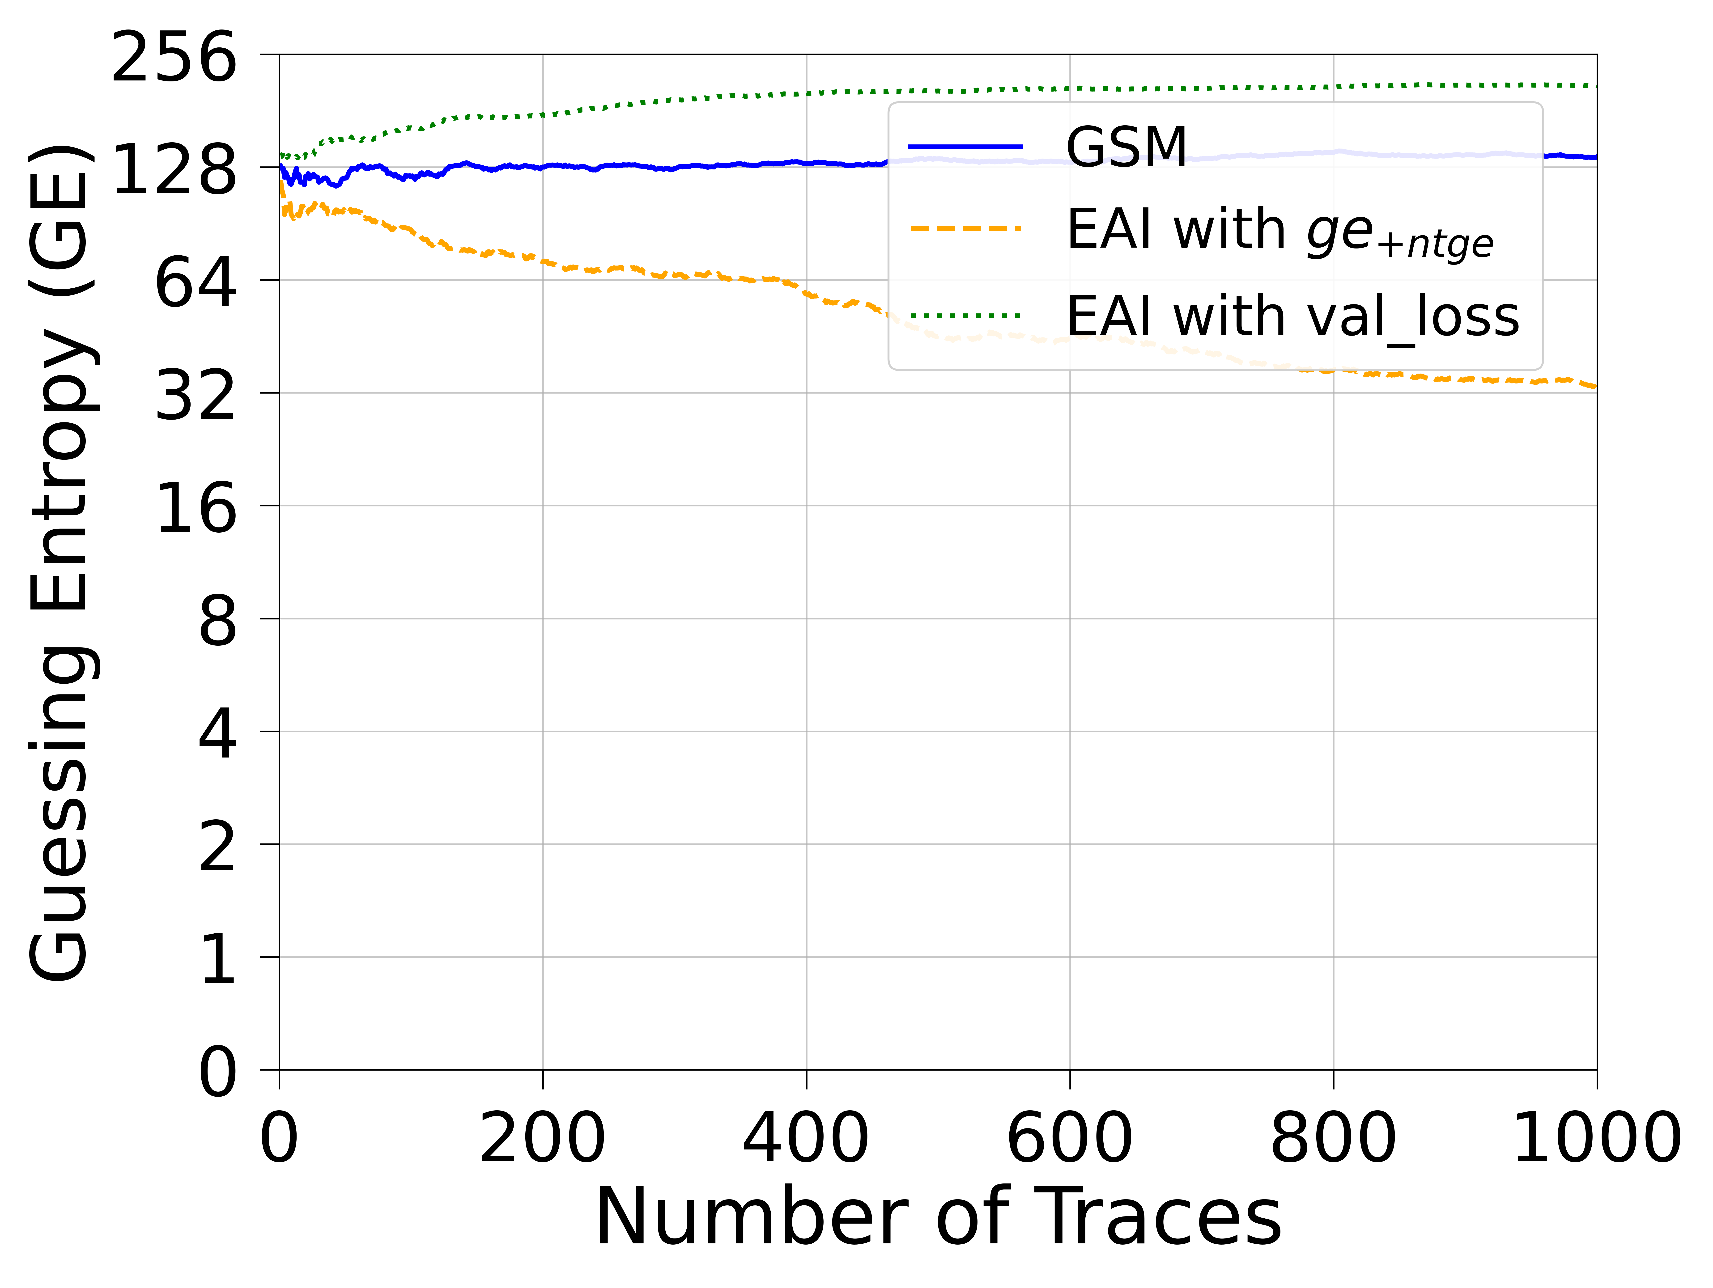
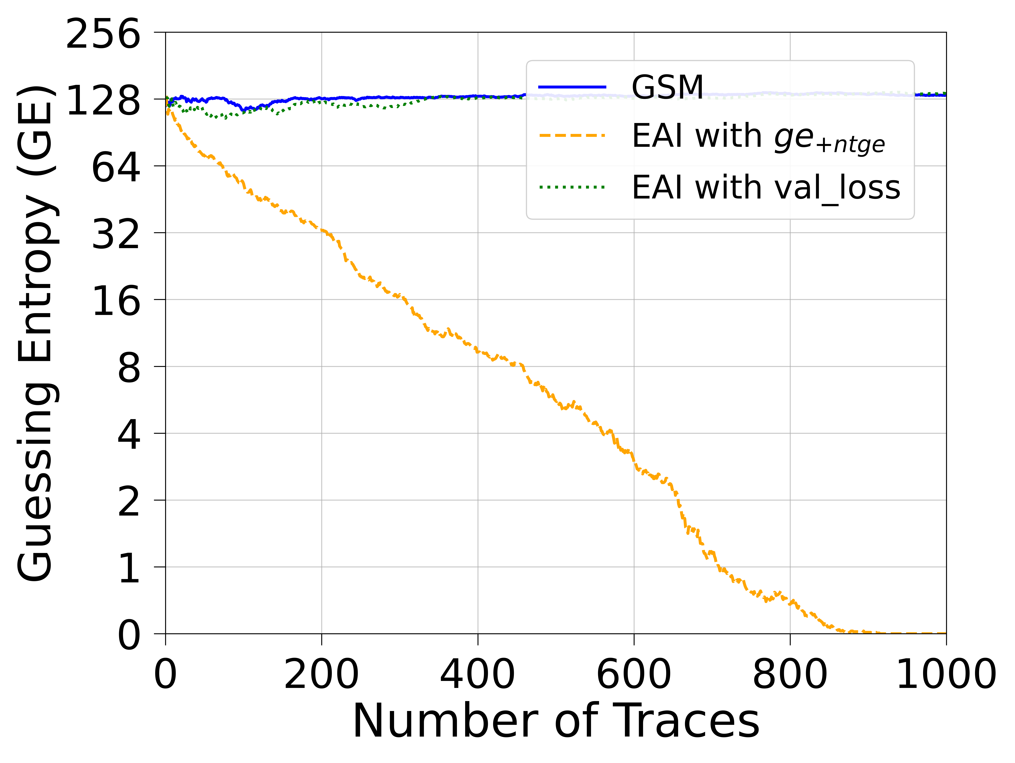
ASCON4
CNN(ID)
MLP(ID)
CNN&MLP(ID)

Slide 45
Conclusion and Future Work
Conclusions
Proposed a novel ensemble selection methodology called EAI for generating well-performing ensembles from pre-trained neural networks
EAI with ge_{+ntge} as fitness function:
Significantly reduces the number of traces required for successful key recovery compared to traditional GSM
Consistently outperforms other methods across five different datasets
Successfully recovered the secret key across all tested datasets
EAI with val_loss as fitness function:
Did not find well-performing ensembles
Often performed worse than GSM
Shows that choosing the right fitness function is critical
Recommendation: Use ge_{+ntge} as the primary fitness function when employing EAI
Trade-off: EAI demands more computational resources and longer execution times.If resources are limited, GSM remains a preferable alternative

